Slide 1


Low Mood Resource Pack Paediatric Psychology Services Wexham Park Hospital
Produced by:
Maria Langridge, Assistant Psychologist
Dr. Lara Payne, Clinical Psychologist
Dr. Jenny Cropper, Clinical Psychologist
1
Developed by:
Maria Langridge, Assistant Psychologist , Dr Lara Payne, Clinical Psychologist, and Dr Jenny Cropper, Clinical Psychologist.

Slide 2
Contents
2
What Is Low Mood and Depression?..............................................................(p.3)
The Connection Between Thoughts, Feelings, and Behaviour…………………….(p.4)
Physiological Support and Sleep Management….………………………………………..(p.5)
Contents: Guided Self Help Worksheets……………………………………………………..(p.7)
Calming the Mind……………………………………………………………………………………….(p.8)
Calming the Body………………………………………………………………………………………(p.15)
What Is Self-Harm?........................................................................................(p.17)
Information for Parents, Teachers, and Carers………………………………………….(p.18)
Online Support…………………………………………………………………………………………(p.19)
Local Support……………………………………………………………………………………………(p.20)
Developed by:
Maria Langridge, Assistant Psychologist , Dr Lara Payne, Clinical Psychologist, and Dr Jenny Cropper, Clinical Psychologist.

Slide 3
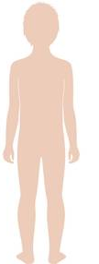
What Is Low Mood and Depression?
3
Many young people experience feelings of low mood. Low mood can be temporary, and pass within a couple of days or weeks, or it can last longer. It is sometimes referred to as depression, especially if it lasts longer than two weeks and starts to affect all areas of life. Low mood and depression can be caused by a change in situation or circumstances, or a difficult event like a death in the family. It can also be related to stress, friendship or relationship problems, and physical health problems.
Risk Factors
There are some risk factors which are linked to a high risk of developing low mood and depression, including;
Bullying
Bereavement
Substance misuse
Isolation
Difficulties at home
Family history of low mood and depression
How Depression Feels
Depression can affect different people very differently. Here is how some people feel;
Depressed (low) mood most of the day almost every day
Reduced interest or pleasure in activities most of the day
Significant weight loss or gain, or decrease/increase in appetite
A slowing down of thought and being less physically active (observable by others)
Fatigue or loss of energy most days
Feelings of worthlessness
Thoughts of/actually self-harming
Feeling that you don’t want to be here anymore
When you low you may notice a number of changes in how you think, feel, and behave. Circle the signals you notice when you feel low:
Use this space to write down other feelings you experience:
____________________________________________________________________________________________________________________________________________________________________________________________________________________________________
Tearful
Feeling sad
Changes in eating habits
Not wanting to do anything
Anger or frustration
Feeling numb
Low self-esteem
Lump in throat
Feeling tired and lacking energy
Thinking everything is hopeless
The number of children and young adults with depression in the UK continues to grow, with an estimated 1 in 20 experiencing it. Depression and anxiety commonly occur together; about half of people diagnosed with depression also experience anxiety.

Slide 4

The Connections Between Thoughts, Feelings, and Behaviour
Some people experiencing low mood and depression can get caught in an unhelpful cycle, resulting in withdrawal from previously enjoyed activities, sleep disturbances, and isolation. It is important to recognise this cycle is so we can break it, and begin enjoying life again.
Situation
Who? What? When? Where? How?
A friend ignores me at school
Thoughts
What went through my mind at the time?
I am useless
My friend doesn’t like me
Feelings
What did I feel at the time?
Sad, Low
Frustrated, Lonely
Bodily Sensations
What did I notice in my body? What did I feel? Where did I feel it?
Tired, no energy
Heavy feeling in chest
Behaviour
How did I respond to the current situation?
Overthinking
Avoiding seeing and talking to my friend
Staying in my room, not doing normal afterschool activities
Tips: For younger children exploring their emotions using this model, try using a smiley face system.
Angry Sad Confused Happy
Disappointed Worried Excited
Nervous

Slide 5
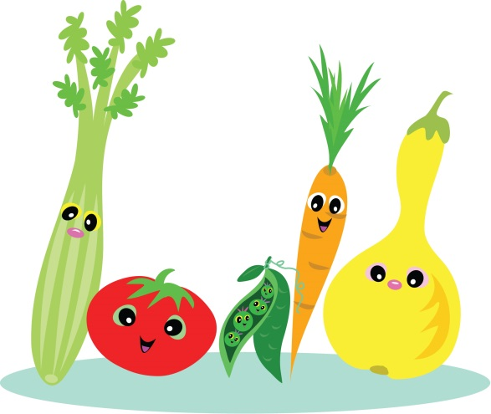
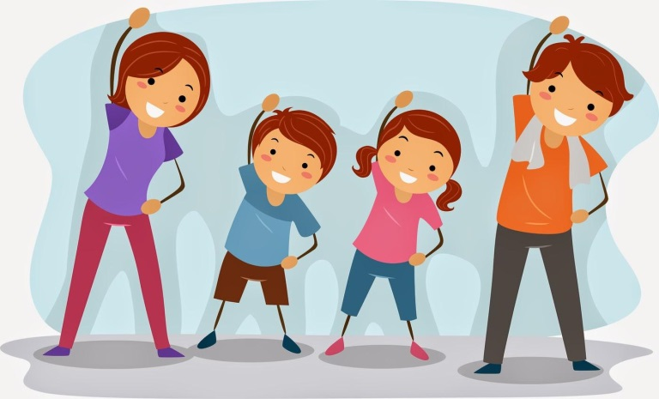
Ways to manage low mood: Having a healthy body
5
Eat a balanced diet!
The brain is one of the most metabolically active parts of the body, and needs a regular influx of nutrients to function. Eating only a small range of foods may mean that the brain does not get the nutrients required to produce the brain chemicals which are important in mood. Eating a healthy, balanced diet is an important part of maintaining good health, and can help you feel your best.
A balanced diet:
Emphasizes fruits, vegetables, whole grains, and low fat milk products.
Includes lean meats, poultry, fish, beans, eggs, and nuts.
Is low in saturated fats, cholesterol, salt, and added sugars.
Stays within your daily calorie needs.
Includes lots of fluids (at least 6-8 glasses a day!)
Exercise Regularly
Exercise releases endorphins, which are hormones that can help you feel happy. Regular exercise can boost your mood if you have depression. Try to start with something you enjoy (e.g. dancing, riding a bike) as it will be easier to do the recommended amount of at least 60 minutes per day.
Participating in an exercise program can:
Increase self-esteem
Boost self-confidence
Create a sense of empowerment
Build friendships and prevent isolation
Any exercise is better than none. Even a brisk 10 minute walk can clear your mind and help you relax.
Developed by:
Maria Langridge, Assistant Psychologist , Dr Lara Payne, Clinical Psychologist, and Dr Jenny Cropper, Clinical Psychologist.

Slide 6

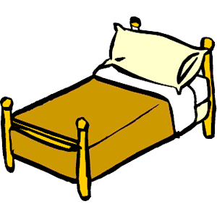
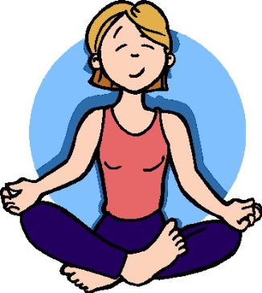
Ways to manage low mood: Sleep Management
6
Sleep difficulties are very common in individuals with low mood. It is important to develop positive sleeping behaviors to promote a balanced lifestyle.
Routine
Sleep at regular times each night - this programs the brain and internal body clock to get used to a set routine.
It is important to try and wake up around the same time each day. If you have a bad night, still try to wake up at the same time in the morning. ‘Catching up on sleep’ on a regular basis can disturb your sleep routine.
The amount of sleep you need changes as you grow. Please refer to the table on the next page to help determine how much you/your child should be sleeping.
Preparing Your Room
Make your bedroom just for sleep, try to avoid eating your meals in bed, or playing games in bed. Your bed should be for sleeping only.
Keep your bedroom tidy and free of distractions at bedtime - clear away any toys or clothes lying around.
Keep the room at a good temperature and try to reduce light. Keeping light levels dim encourages the body to produce the sleep hormone, melatonin. If you are worried about the dark, you could try having a small night light.
Wind Down Before Bed
Having a warm bath can help your body to reach a temperature that is ideal for rest.
Avoid using smartphones, tablets, or other electronic devices for roughly an hour before bed. The light from the screens of these devices may have a negative effect on sleep.
Relaxation exercises, such as light yoga stretches and those included later in this pack can help to relax the muscles. However, vigorous exercise will have the opposite effect.
If your mind is busy, write a to-do list for tomorrow or write down your thoughts. This will help to organise your thoughts and clear your mind of any distractions.

Slide 7
Breaking the Cycle: Challenging Negative Thoughts and Behaviours
7
Calming The Mind - Strategies for managing the distress that is often associated with low mood
Changing behaviour..…………………………………….………………………………………………………………(See p.8)
When some people are experiencing low mood, they can withdraw from participating in previously enjoyed hobbies. It is important to increase the amount of positive and engaging activities amongst children/young adults experiencing low mood.
Goal Setting…………………………………….……………………………………………………………………………(See p. 9)
Experiencing low mood can cause you to stop taking part in activities you enjoy. Goal setting is about working out what you would like to be able to do, and working towards achieving it in smaller, more manageable steps.
Distraction………………………………….…………………………………………………………………………………(See p.10)
Distraction uses a very important principle: shifting your attention to something neutral or positive is much easier than shifting your attention away from something that is negative.
Worry Time……………………………….…………………………………………………………………………………..(See p.11)
This cognitive behavioural tool can help you develop control over the frequency and timing of your worry. By learning to contain your worry to designated periods, you can free up the mind for other important, fun, or interesting activities.
Developing Coping-Self Talk…………………………………………..…………………………………………....(see p.12)
These are phrases that you can say to yourself that are supportive. For example “Just because it has happened before it does not mean it will happen again”
Visualisation…………………………………………………………………………………………………………...….…(see p.13)
Help yourself to feel more relaxed by thinking about things that make you feel calm and rested. For example, picturing your favourite place. This can be either independent, or you can take a guided visualisation approach. A guided visual imagery relaxation task has been provided in this pack.
Safe Place Visualisation……………………………………………………………………………………….…………(see p.14)
A powerful stress reduction and relaxation tool, that can be applied at any time, in any location.
Calming The Body - Feeling relaxed can help reduce symptom severity
Progressive Muscle Relaxation (PMR)…………………………………….………………………………………(See p.15)
Muscle tension is commonly associated with stress and anxiety, it is the bodies natural response to potentially dangerous situations. Even when there is no danger, our bodies can still respond in the same way. You may not always realise that your muscles are tense, it may be as subtle as your jaw clenching, or as obvious as your shoulders feeling really tight and hunched. PGR is a deep relaxation technique which is based upon the simple practice of tensing one muscle group at a time . This is followed by a relaxation phase with release of tension. This is very useful before bedtime.
Deep Breathing.…………………………………………………………………………………………………….....….(See p.16)
During deep breathing your blood is oxygenated, triggering the release of endorphins, whilst also decreasing the release of stress hormones, and slowing down your heart rate.

Slide 8
Changing Behaviour and Enjoying Yourself
8
When we feel sad or low in mood, we often stop doing things that we used to enjoy. However, avoiding things often makes us feel worse in the long-term.
The first step is to think about things you have stopped doing/are doing less/are avoiding as a result of feeling low in mood. Make a note below of things you are avoiding because of how you are feeling.
Things around the home:
Things at work or school:
Hobbies and interests:
Social activities with friends and family:
Anything else?
2. Once you have filled in Section 1, the next step is to plan how easy it would be to start doing some of the avoided activities again. Create a ladder (hierarchy) of tasks with the most difficult at the top, and the easiest at the bottom. Try to include a good mix of the things you wrote down in Section 1. Before completing each task, write down what you think will happen, and follow this up by writing down what actually happened after task completion. Hopefully you will start to see that it is mostly not as bad as you think it is going to be. If a task feels too difficult, try to break it down into smaller, more manageable parts. Approach this step by step, do not try to complete all tasks at once.
Situation Difficulty (0-10)
Example: going to school
10 (most difficult)
Example: texting a friend
1 (least difficult)

Slide 9





Having low mood can cause you to stop taking part in activities you enjoy. Goal setting is about working out what you would like to be able to do, and working towards achieving it. Goal setting is a powerful way of improving your quality of life and sense of control. It is important that goals are meaningful to you and feel good.
9
Goals
Specific: clearly state what you would like to happen
Measurable: will you be able to say it was achieved?
Achievable: are you able to complete the task independently?
Realistic: are you going to do it?
Timely: think whether it is ‘the right time’ to do this. Set yourself a realistic time limit to achieve this goal.
Specific
To create a specific goal it must answer the 6 ‘W’s.
WHO is this goal for/who is involved in it?
WHAT is it that needs to be accomplished?
WHERE should this goal take place?
WHEN will this goal be completed, or how long will it take?
WHICH things or requirements, and constraints, need to be identified?
WHY does this goal need to be accomplished? What is its purpose?
For example:
‘I want to use Progressive Muscle Relaxation to help manage my pain’ as a SMART goal would be:
‘I want to use Progressive Muscle Relaxation 30 minutes, everyday at home for one month, to reduce my symptom severity’.
Measurable
Measurable goals make it easier to stay on track to meeting your goals. Questions like ‘how much’, or ‘how many’, or ‘how will I tell if I met my goal’ is a good way to determine what to measure. For example, practicing Progressive Muscle Relaxation for 30 minutes everyday is quantifiable and measurable. You can track your progress and see results.
Realistic
When you are coping with low mood you need to have goals which are realistic and reasonable. It is easy to get ahead of yourself. Sometimes people fall into the trap of getting overwhelmed by goals which seem impossible. Make a realistic goal by breaking into smaller goals.
Timely
An important factor in achieving your goals is seeing the progress you have made. Set a time limit to complete your goal. For example, practice progressive muscle relaxation for 30 minutes each day, for a month before you tackle another goal. Write down your progress, seeing progress can motivate and encourage you.
A goal is something that you are motivated to work towards and achieve. When you are working on activity levels, it is important to set goals that can help to both motivate you, as well as direct your efforts and energy.
Doing more
Mood can be greatly affected by what we do, when we do it, and with whom.
Keep track of what you do each day and make sure you are spending your time doing enough things that give you a sense of:
A - achievement
C – closeness to others
E – enjoyment
Being mindful of these 3 things when goal setting may help you to set meaningful SMART goals. Doing more also allows less time for negative and unhelpful thoughts and overthinking, which will have a positive effect on mood.

Slide 10
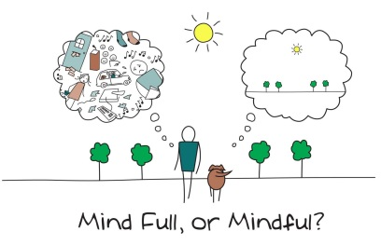
Changing Behaviour: Distraction Techniques For Low Mood And Depression
10
Let It Out Physically
Scream as loud as you can.
Hit a pillow.
Squeeze a stress ball.
Play loud music and dance energetically, be as wild as you like!
Expand some energy – go for a brisk walk/swim/bike ride/running.
Working out how you are feeling…
Ask yourself: Do I feel angry? Anxious? Low? Numb? What is making me feel like this? What has triggered this feeling?
Write a list of your achievements.
Write yourself a letter saying ‘I love YOU because…’
Make a list of thinks you are thankful for.
Creativity as a way of expression
Draw/paint/use any artistic medium to produce a piece of art depicting how you are feeling.
Write a poem/ story/ song/ joke/ musical about how you are feeling.
Draw on yourself (with skin safe ink).
Play an instrument/sing as loud as you can.
Put on music which expresses how you are feeling.
Write out the soundtrack to your life as if it were a film.
Comforting yourself
Have a warm bubble bath or shower.
Stroke a pet/cuddly teddy.
Cuddle a friend/family member.
Pamper yourself.
Practice yoga and meditation.
Distract yourself
Watch TV/movies.
Play on a computer.
Do puzzles/play chess.
Make a t-shirt.
Look for pictures in the clouds.
Learn a new skill (e.g. juggling/speaking another language/drawing).
Playing with brother/sister/friend
Getting out and about
Take the dog for a walk
Ride your bike
Help parents with chores around the house
Mindfulness
Mindfulness is about paying attention on purpose, and simply noticing what is happening right now. Mindfulness is taking notice of how your body feels, what you see, smell and taste.
Mindfulness can be a group, 1:1, or individual activity. You can practice mindfulness anywhere you feel comfortable. There are many benefits to becoming more ‘mindful’ and accepting of your thoughts and feelings.
For more information on mindfulness, have a look at:
The Mindful Coffee Meditation - https://www.the-guided-meditation-site.com/the-mindful-coffee-meditation.html
Headspace (website, app) - https://www.headspace.com/
Omvana (website, app) - https://www.omvana.com/
Buddhify (app)
BellyBio (app)
Wherever You Go, There You Are, Jon Kabat-Zinn (book).
Being Productive
Catch up on chores and homework.
Cook/bake something (always have supervision when in the kitchen!).
Have a clear out – donate your old clothes and toys to charity.
Rearrange your room.
Volunteer somewhere.
Think about what you would like to change about your life and make a plan.

Slide 11


Calming the Mind: Reducing Overthinking
11
Using Worry/Overthinking Time
It is well known that overthinking is fuel for low mood. Overthinking can start to happen at any time or place, and get in the way of things you want to do. People who often overthink and whose minds appear to be constantly “on-duty” can find it helpful to postpone their worry/overthinking to a set time in the day. Using a set time can be a good way to limit and reduce overthinking, and to stop fueling low mood.
Step 1: Create a set worry/overthinking time
What time of the day would this work best? It can be any time of day when you have some free time (e.g. after school, on the bus on the way home)
Do not do worry/overthinking time before bed, as this may affect your sleep.
Make sure worry/overthinking time is no longer than 10-15 minutes
Step 2: Postpone overthinking
When a stressful or worrying thought comes to mind notice the urge to worry, then tell yourself “I don’t need to think about this now, because I can worry about it later”.
Make a brief note of the thoughts on a small notepad or on your phone so that you don’t forget it and can come back to it at your set overthinking/worry time.
Do your best to distract yourself with something else and let the thought go for now.
Step 3: Complete worry/overthinking time at agreed time
When it comes to the time you have set aside, return to your list or notepad and allow yourself time to think about the things you have written down (see example below)
You may find that you do not need to think or worry about some things on the list anymore. This is great – move onto the next one.
Be strict and stop when the 10-15 minutes is up – set a timer if you need to! If there are any thoughts left on the list when the time is up, leave them on there for tomorrow.
It takes time, patience, and practice to develop this skill. By learning to limit overthinking to only one part of your day, you can take more control over it, and mood will hopefully improve.
Today’s list
I said something silly to my friend in class yesterday and they might think I am annoying
I have to go to the dentist tomorrow
I have lots of homework to do

Slide 12

Calming the mind: Developing Coping Thoughts/Positive Self-Talk
Positive statement encourage us and help us cope through distressing times. We can act as our own coach by saying encouraging thigs to ourselves. Creating a sentence that you can say to yourself when you are feeling low or struggling to cope can be very useful. Some children keep a copy of these in their pencil case or wallet so that they are always available.
12
“I can do this.”
“I can cope.”
“Keep calm and carry on.”
“Thoughts are just thoughts – they are not necessarily fact.”
“It is okay to feel this way, it is a normal reaction.”
“This is difficult and painful, but it is only temporary.”
“This wont last forever.”
Activity:
Fill in the empty boxes with positive statements you would use in each example situation.
Situation | Coping Thought/Positive Statement
Example: For the past few weeks I have been finding it hard to get out of bed. Today I have been in bed all day and have not got dressed. | I can do this. This feeling will not last forever. I have friends and family who care about me and support me.
I have been having very distressing thoughts that are making me very tearful.
I am feeling unwell and very tired.

Slide 13

Guided Visual Imagery Relaxation: The Beach
Lay down, or sit comfortably in a quiet room. Use the deep breathing techniques you learnt earlier in this pack, close your eyes and listen to somebody read you the following script. You can also read this script to yourself. You may find it more relaxing to play an audio track of crashing waves on the beach; this can be sourced on YouTube, Spotify, and most other online music platforms.
You’re walking down a long wooden stairway to a big, beautiful beach. It is very quiet and stretches off into the distance as far as you can see. As you look down you notice that the sunlight is reflecting off of the golden sand. You step into the sand, it feels warm so you wriggle your toes. You notice the warmth from the sand between your toes and around your feet. You notice the sounds of the waves crashing and chasing you up the shore, the water sparkles like a diamond as it retreats back. The roaring sound of the waves is so soothing that you can just let go of any worries.
The ocean is a beautiful light blue, with patches of darker sapphire in the deep. As you look at these deep blue areas you notice a small sailboat on the horizon. All of these sights help you to let go of any worries and relax even more.
As you continue walking along the beach, you become aware of the fresh salty sea air. You look up take a slow deep breath in, and breath out. This breath makes you feel refreshed and relaxed. As you look up you notice two seagulls, the wind gusts and they appear to dance in graceful circles above you. It makes you wonder how it would feel if you could fly under the warm sun.
You find yourself settling into a deep state of relaxation as you walk further down the beach. You feel the sun wrap its warm arms around you, the warmth relaxes all of your muscles. You notice a beach chair as you walk down the beach, once you reach it you take a seat. Laying back in this comfortable chair makes you reflect on everything you have felt, seen and thought at this beach. You drift into a deeper state of relaxation.
Now, feeling relaxed and at peace, you slowly rise from the beach chair and step into the warm sand to walk home. As you walk, you remember how relaxing this beach has been, and you know that you can come back to this place anytime you like. You start to climb the wooden stairs and gradually bring yourself back into the room. When you are ready, you can open your eyes.
13

Slide 14
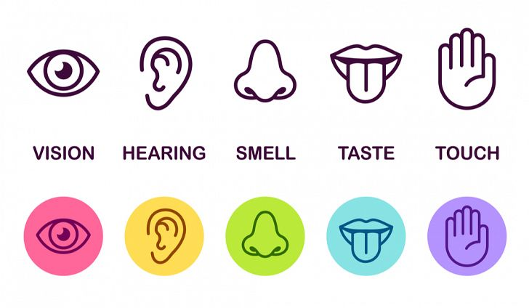
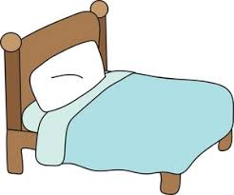
Relaxing Safe Place Imagery
14
All visualisations can be strengthened by engaging all of your senses in creating your ‘Safe Place’. If you any negative thoughts enter your positive imagery, discard that image and create another one.
Get comfortable in a quiet place where you won’t be disturbed. Sit, or lie, comfortably. Take a few minutes to practice some deep breathing, become aware of any tension in your body, and release it with each breath.
Imagine a place where you can feel safe and relaxed. Your safe place can be somewhere you have been on holiday, somewhere you have seen a picture of, or a completely new place you create. Avoid using your home as your safe place.
Look around your safe place, pay attention all the colours and shapes around you. Describe what you see aloud.
Now focus on what you can hear. Listen to the sounds far away from you, and those close to you. Perhaps you hear is silence. You may hear the sound of running water, or the crunch of leaves under your feet.
Now focus on any skin sensations. Notice the feel of the ground beneath your feet, or whatever is supporting you in this place. Pay attention to the temperature and direction of the wind, and anything else you can feel.
Take a deep breath in. Place your hand on your stomach, and imagine a balloon inflating in your stomach. Can you notice any smells there? Maybe you can taste the salty sea air as you inhale?
Pay attention to all of these sensations whilst you spend time relaxing in your safe place.
Whilst you’re in your safe place, give it a name that you can use to bring that image back at any time.
You can choose to stay for a while, enjoying the calmness and tranquillity. You can leave when you are ready by slowly opening your eyes and bringing yourself back to alertness in the present.

Slide 15















Progressive Muscle Relaxation
15
Get comfortable in a distraction free environment. You can either lay down or sit upright in a chair. Closing your eyes will help you focus on the different muscle groups, but you do not have to if you don’t want to! For all steps, hold the tense position for a couple of deep breaths, or however long is comfortable for you, then relax. Repeat each step three times.
Draw a deep breath in through your nose and feel your abdomen rise as you fill your body with air. Then slowly exhale from your mouth, pulling your belly-button towards your spine.
Start with your feet. Clench your toes with your heel pressing towards the ground. Squeeze tightly for a couple of breaths and then release. It may help to say ‘relax’ whilst you release the tension. Next, flex your feet with your toes pointing towards your head.
Next move to your legs. Stretch your leg out, with your toes pointing towards the sky, feel the back of your leg tightening. Hold this for a couple of deep breaths and then release. Then, point your toes down into the ground with your leg straight for a couple of deep breaths.
Now move onto your glutes. Squeeze your buttocks muscles for a couple of deep breaths. Remember, you should only feel tension and not pain.
To tense your stomach and chest, pull your belly button in towards your naval as tight as you can. Breath in deeply, filling up your chest and lungs with air.
Next, tense your shoulder blades and back. Push your shoulder blades backwards, as if you are trying to get them to touch. This will push your chest forwards.
Now tense the muscles in your shoulders as you bring your shoulders up towards your ears.
Be careful when tensing your neck muscles! Face forward, and SLOWLY pull your head back to look up at the ceiling.
Open your mouth as wide as you can, as if you are yawning, to tense your mouth and jaw.
To tense your eyes and cheeks, squeeze your eyes tight shut.
Raise your eyebrows as high as they will go, as if you were surprised, to tense your forehead.
To tense your upper arms, bring your forearms up to your shoulder to ‘make a muscle’.
Finally, to tense your hand and forearm, make fists with both of your hands.
Practice means progress. Only through practice can you become more aware of how your muscles respond to tensions and relaxation. Training your body to respond differently to stress is like any training – practice is the key!

Slide 16

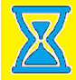
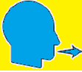
Calming The Body: Deep Breathing
16
During periods of low mood we can experience anxiety, the body triggers the Fight or Flight Response. Breathing is shallow, uncontrolled, and muscles become tense. Deep breathing triggers the Relaxation Response, whereby breathing becomes deeper, controlled, slower, and the symptoms of anxiety reduce.
Sit or lie down comfortably. Close your eyes if it makes you feel more comfortable. Place your hand on your stomach, if you breath deeply enough, you should notice your hand rising and falling with each inhalation and exhalation. Imagine a balloon blowing up in your stomach as you breath in, and deflating as you breath out.
1. Inhale. Breath in slowly through your nose for 4-8 seconds.
2. Pause. Hold the air in your lungs for 4-8 seconds (however long is most comfortable for you).
3. Exhale. Breath out slowly through your mouth for 4-8 seconds.
Repeat. Practice for at least 2 minutes. As your technique improves, practice for 5-10 minutes.
Tips
Slow down. The most common mistake is breathing too quickly. Count each step slowly as you do so.
Counting your breaths takes your mind off of the source of anxiety. Counting acts as a distraction, whenever you catch your mind wandering, return to counting.

Slide 17


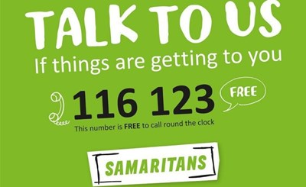
What Is Self-Harm?
17
Self-harm is defined as hurting yourself or damaging your health on purpose. Although it is often very worrying for young people and their families, self-harm is also very common. One in five young people self-harm, and 10% of 15-16 year old individuals self-harm.
There are lots of ways to cope with feeling the need to self harm.
Why Do People Self-harm?
People self-harm for various reasons. Some people say that self-harm can provide a feeling of control, in what seems like an uncontrollable and overwhelming situation. Others use self-harm as a relief from difficult feelings building up inside, to let them out. Some people say they use self-harm to ‘feel something’ after long periods of feeling numb or ‘flat’. It is important to realise that self-harm does not necessarily always mean someone is suicidal.
How Do I Tell Someone I Self-Harm?
Talking is important because it means you do not have to deal with everything alone. It can be difficult to know exactly why anyone self harms, so trying to explain it to someone else can feel even harder. It is really important to talk about the feelings that lead to self-harm with someone in your life that you trust. This may be a parent, teacher, a trusted adult or a friend. You can also talk to your doctors or nurse at any time. It can be helpful to think about what you want to say in the conversation. Some young people prefer to write it down in a letter.
For parents of young people that engage in self-harm, it is important to talk honestly and calmly with your child, and think together about how you can support them to keep themselves safe.
Staying Safe
It is really important to seek medical attention for any wounds or cuts that are concerning you. Do not rely solely on the internet for medical information. You can also seek advice from a school nurse, teacher, or your GP. It is also important to look after any wounds of cuts if you have hurt yourself. If your life is in danger call 999 straight away or go to A&E.
Support For Self-Harm
YoungMinds Parents Helpline, call free on 0808 802 5544 (Mon-Fri 09:30 – 16:00)
Samaritans Helpline, call free on 116 123 (24 hours a day, 365 days a year), or email at jo@samartians.org.

Slide 18







Information for Parents, Teachers, and Carers: SUPPORT Your Child
Show your child/young adult how to successfully approach and cope with difficult situations. Model success.
Understand that your child has a problem. Remember that your child is not being wilfully naughty or difficult. They have a problem and need your help.
Patience. Do not expect things to change instantly, recovery is a process. Be patient and encourage the child/young adult to keep trying. Let them know you are available to talk as needed.
Prompt new skills. Encourage and remind the child/young adult to practice and use the new skills they have learnt from this pack.
Observe the child/young adult. Watch your child and highlight the positive or successful things they do.
Reward and praise their efforts. Remember to praise and reward the child/young adult for using their new skills and for trying to face and overcome their problems.
Talking about it. Talking with the child/young adult shows them that you care and will help them feel supported. Some young people also find it helpful to schedule ‘check ins’ with parents e.g. 10 minutes after school to discuss how they are feeling that day.

Slide 19
Online Support
Apps:
Mindfulness and Sleep:https://www.smilingmind.com.au/
Meditation and Sleep:https://www.calm.com/
Meditation: https://www.headspace.com/kids
Progressive Muscle Relaxation: https://www.thinkpacifica.com/
‘Calm Harm’ - free and provides tasks that you can do when you have the urge to self harm. You can add your own tasks too.
‘Distract’ - Very good for signposting to other services, and has some self-harm educational information as well as links to Art, Books and Films.
‘Self-Heal’ - when opening this you get three options: what to do now, what to do in the longer term or contact The Samaritans. It also has a toolbox of resources and allows users to collect pictures, quotes and distraction tasks that they believe will be of most benefit to them.
Websites:
Online Mental Health Guides: http://www.youngminds.org.uk/
Free Online Counselling: https://www.kooth.com/
Online support service, contactable by text: https://giveusashout.org
Stress and Anxiety: https://www.moodcafe.co.uk/for-children-and-young-people/feeling-worried,-frightened,-stressed-or-anxious.aspx
Anxiety and Depression: https://www.nhs.uk/conditions/stress-anxiety-depression/anxiety-in-children/
Mindful Breathing: www.getselfhelp.co.uk/mindfulness.htm
Mindful Activity: www.getselfhelp.co.uk/mindfulness.htm
Relaxation Techniques: www.getselfhelp.co.uk/relax.htm
Relaxing Imagery: www.getselfhelp.co.uk/imagery.htm
Thought Distancing: www.getselfhelp.co.uk/cbtsetp6.htm
Supporting Sleep: www.getselfhelp.co.uk/sleep.htm
Self Help for Insomnia: https://www.getselfhelp.co.uk/sleep.htm
What to do about self-harm?: https://youngminds.org.uk/find-help/feelings-and-symptoms/self-harm/#what-to-do-about-self-harm?
Coping with self-harm: a guide for parents: https://www.cwmt.org.uk/resources & http://www.healthtalk.org/ & https://www.rcpsych.ac.uk/healthadvice/parentsandyoungpeople/parentscarers/self-harm.aspx
When accessing online resources and communities, it is important that children and young adults are supervised, and are aware of online safety.
Books:
Sitting Still Like a Frog: Mindfulness Exercises for Kids – Eline Snel
Am I Depressed and What Can I Do About It? – Shirley Reynolds and Monika Parkinson
Overcoming Teenage Low Mood and Depression: A Five Areas Approach – Nicky Dummett and Chris Williams
Stuff That Sucks - Ben Sedley
The Parent’s Guide to Self-Harm: What Parents Need to Know – Jane Smith
Parent Support:
For advice on your child’s emotional wellbeing, contact Young Minds Parent Line: 0808 802 5544; www.youngminds.org.uk/find-help/for-parents/parents-helpline

Slide 20
Local Support
20
No5
101 Oxford Road, Reading, Berkshire,
RG1 7UD
Counselling phone: 0118 901 5668
Admin phone: 0118 901 5649
Email: info@no5.org.uk
Free, confidential counselling to support children and young people aged 10-25, living in the vicinity.
Youth Enquiry Service (YES)
52 Frogmoor, High Wycombe, HP13 5DG
Contact number: 01494 437373
Email: info@yeswycombe.org
Free confidential counselling for young adults aged 13-25, living in the vicinity.
ARC Youth Counselling
35 Reading Road, Wokingham, Berkshire, RG41 1EG.
Contact number: 0118 977 6710
Email: coordinator@arcweb.org.uk
counsellor@arcweb.org.uk
Free and confidential counselling for those up to the age of 18, living in Wokingham .
Number 22
Where to go:
27 Church St.
Slough, Berkshire
SL1 1PL
Who to contact:
Telephone (Youth Talk, Windsor): 01753 842444
Telephone (Number 22, Maidenhead): 01628 636661
Free and confidential counselling for 12-25 year olds, living in the vicinity.
Youth Concern
The Uptown Coffee Bar, Whitehill Lane, Aylesbury, Buckinghamshire, HP19 8FL.
Contact number: 01296 431183
Email: http://youthconcern.org.uk/
Free and confidential counselling for young people aged 13-25 living in Aylesbury Vale, Buckinghamshire.
Local Child Mental Health Services
If you have serious concerns about yourself or a child/young adult with low mood, you can self-refer to Buckinghamshire or Berkshire Child and Adolescent Mental Health Services:
Buckinghamshire CAMHS - 01865 901951 https://secureforms.oxfordhealth.nhs.uk/camhs/Buckinghamshire.aspx
Berkshire CAMHS – 0300 365 1234
https://forms.berkshirehealthcare.nhs.uk/cypf/

