Slide 1
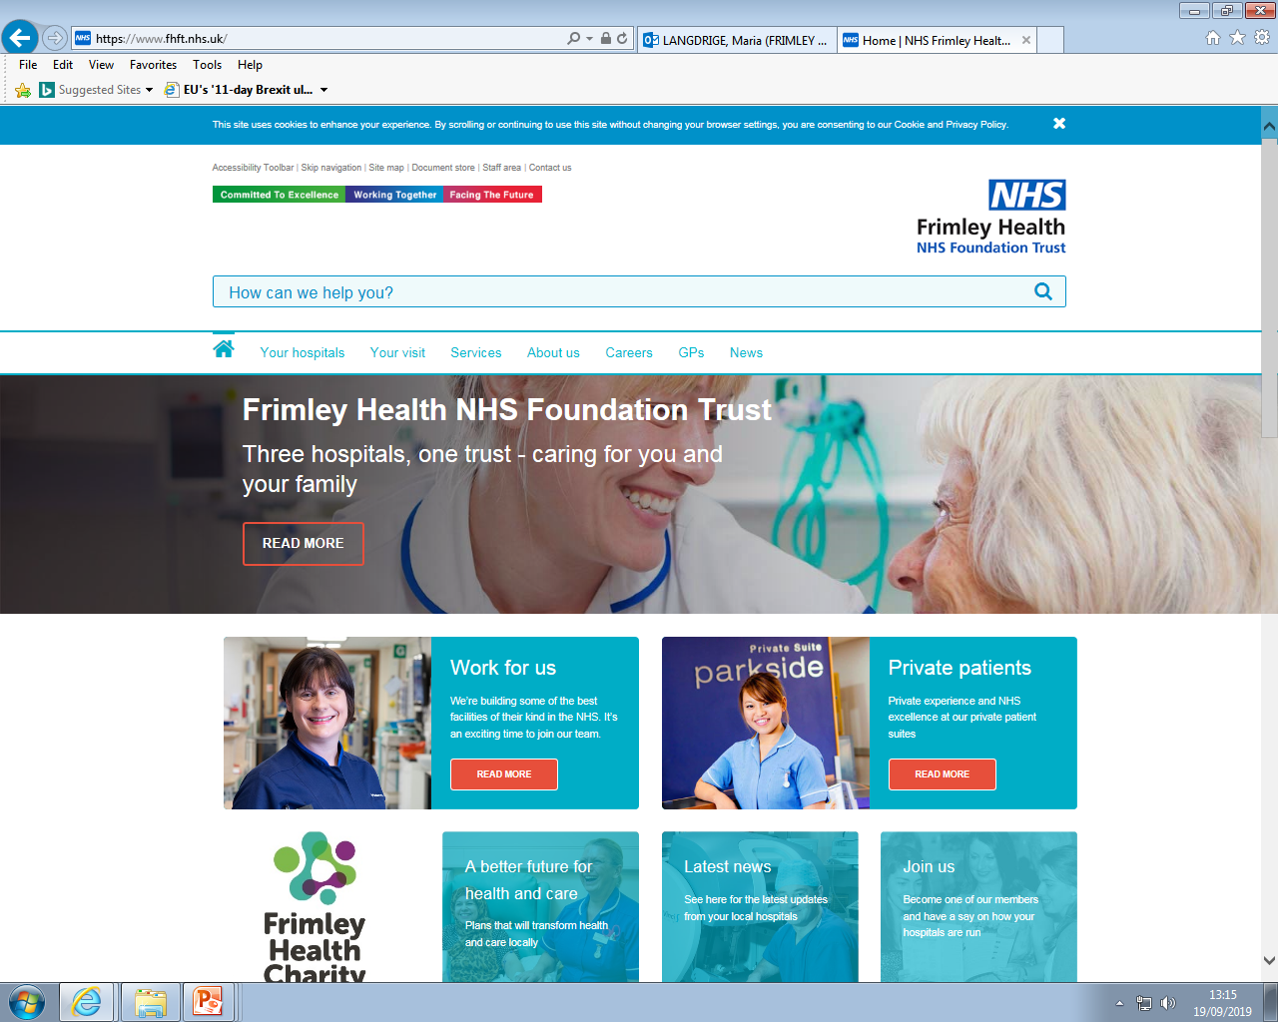

Managing the Emotional Impact of a
Long Term Health Condition
Paediatric Psychology Services
Wexham Park Hospital
Produced by:
Dr. Hayley Thompson, Principal Clinical Psychologist
With Thanks for Contributions From:
Jessica Stacey, Undergraduate Assistant Psychologist Torileigh Matthews, Trainee Clinical Psychologist
Tamsin Thompson, Paediatric Diabetes Specialist Dietitian
Dr Katie Henderson, Clinical Psychologist
1

Slide 2
Contents
2
The Impact of a Health Condition …………………………..…….See p.3
Adjustment to a Health Condition ...................................See p.4
Resilience: Healthy Bodies Help with Health Minds ………See p.8
Difficult Emotions ………………………………………………………. See p.10
Difficult Thoughts ………………………………………………………. See p.12
Motivation to Change ………………………………………………….See p.13
Burnout ………………………………………………………………..……. See p.14
How Can I Improve my Wellbeing? ………………………………See p.15
Coping with my Health Condition ...................................See p.17
Contents: Guided Self-Help Worksheets……………………… See p.18
Calming The Body………………………………………………………. See p.19
Calming The Mind……………………………………………..………… See p.21
Supporting Children/Young Adults ……………………..…..….. See p.26
Online Support……………………………………………………………. See p.27
Local Support………………………………………………………………. See p.29

Slide 3
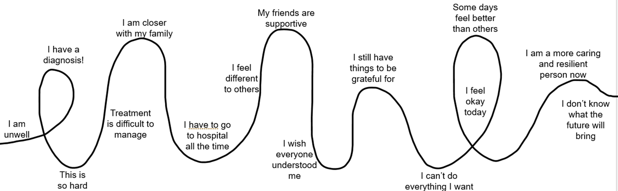
The Impact of A Health Condition
3
There are lots of different types of long-term health conditions that children and young people can be diagnosed with. These include:
Diabetes
Cystic Fibrosis
Respiratory Conditions, like asthma
Epilepsy
Allergies
Genetic conditions
And many more!
We hope that this resource pack gives you some ideas about acknowledging the impact it has had, thinking about how you want your life to be, how you might manage your condition and what to do if you are struggling.
When you are living with a health condition, it is inevitable that you may experience good and bad times with many ups and downs along the way, like you are living on a rollercoaster. We know that there may be times that it feels easier, and times it feels overwhelming.
Noticing there are ups and downs it the first step. It’s a normal part of us adjusting to the health condition and learning to live alongside it. How you feel about it will change over time, and that’s ok!
It can be useful to think back to when you first learned about your health condition. How did you feel about it then? Has anything changed about how you view it now? What do you think led to that change?

Slide 4
Adjusting to a Health Condition
4
Throughout your journey with your health condition there might be lots of different emotions and thoughts that you notice.
Pre-diagnosis
Uncertainty
Fear
Diagnosis
Sometimes relief
Worry
Making sense of it
Confused/ worried
Changing relationship
Worry
Feeling out of control
Lots of new information
Coping with treatment
Coping with life changes
Learning to manage it
Living life alongside it
Finding things easier
Feeling more in control
Telling friends/ family
Having ups and downs
Over time, we start to feel ok riding the rollercoaster.
We start to accept there will be ups and downs.
Support from Health Team
Mindfulness
Adjusting to a health condition takes skills, including:
Resilience, which is our ability to adapt to, and recover from, stress
Coping, which is about how we manage our thoughts, emotions, body reactions and behaviours response to stressful situations
Sense of knowledge
Positive school experience
Support from friends and family
Using coping skills
Hobbies and clubs
Developing self-esteem

Slide 5


Adjusting to a Health Condition
5
Let’s consider how you have adjusted to your health condition.
Fun
Family
Life
Doing well at school
Time to do my Hobbies
First, draw a shape that represents your life, and fill it with words that represent something that is important to you. It might look a bit like this
Friends
Meeting new people
What can I eat?
needing more support
Next, draw a shape that represents your health condition, and fill it with words that you associate with your condition. It might look like this
Worry about health
Health Condition
new information
Worry about future
Remembering medication
hospital visits
When people are first aware of their health condition, it can feel like it completely takes over their life. There is a lot to learn and to think about!

Slide 6
Adjusting to a Health Condition
6
Over time, how we feel about our health condition can change. The health condition itself can feel smaller and like it takes up less of our time. And we start to grow our life around it.
Fun
Family
Doing well at school
Time to do my Hobbies
What can I eat?
Worry
Health Condition
needing more support
new information
Life
Medication
Friends
Hospital
Meeting new people
The goal of adjustment is to feel like your health condition is just a part of you, rather than it defining you. Adjustment is when you live your life alongside your condition, without it always feeling like it takes over. We give it the attention it needs but still focus on the things that are important to us.
Consider where you are in your adjustment to your health condition now. Does it feel like a small part of you? Or does it feel like it takes over at times? It’s normal for it to grow and then become smaller again, particularly if we are stressed or have a lot of other things going on in our lives.

Slide 7
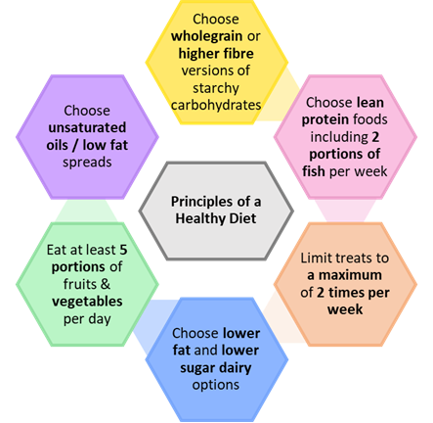
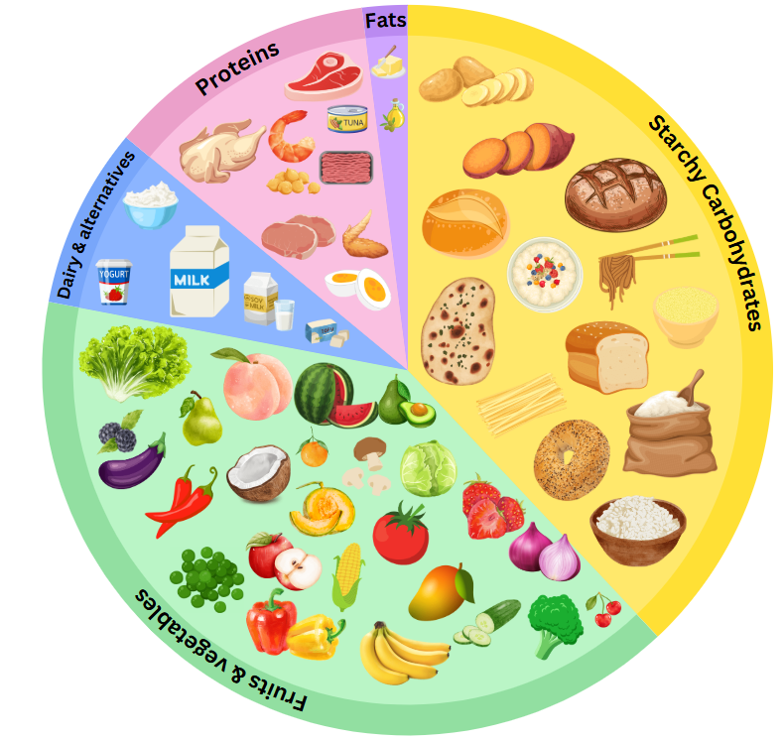
Resilience: Healthy Bodies Help With Healthy Minds.
Diet
7
When we think about developing resilience to the stress of managing a health condition, it is important to start with the basics. Focusing on eating a healthy, balanced diet, doing some exercise and getting enough sleep is the foundation to us becoming resilient.
Let’s start by thinking about what we eat
It’s important to eat the right foods in the correct amounts for a well-balanced, healthy diet. These principles will help both your physical and mental health:
The Eatwell Guide (left) shows you the 5 food groups that we eat.
If you eat a variety of foods from across the guide, you will have a well-balanced diet.
Foods outside of the plate (chocolate, biscuits, cake, crisps, ice cream etc) are not essential to health and should only be eaten in small amounts as treats.

Slide 8
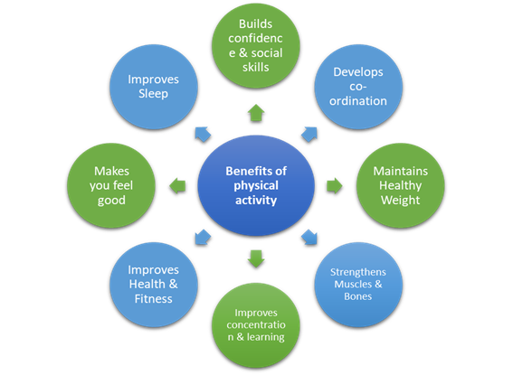
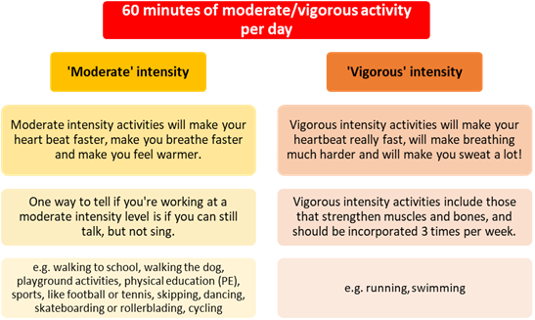
Resilience: Healthy Bodies Help With Healthy Minds.
Energy
8
Think about what physical activities you do. Some health conditions restrict what movement our bodies can do and need to be managed differently during exercise. But we know that being active is associated with better mental health and it is worth trying to find some activities you can do that you enjoy.
There are lots of benefits of being physically active, where your condition allows it.
The physical activity levels recommended for 5–18-year-olds

Slide 9
Resilience: Healthy Bodies Help With Healthy Minds.
Sleep
9
Let’s focus now on sleep. Children and young people often need a lot of sleep, but they can also have erratic sleeping and waking times. When you have a health condition, these times can become even more erratic! The goal is to get enough sleep to wake up feeling refreshed.
When you have a health condition it is particularly important to make sure you are getting good quality sleep. Some advantages of good quality sleep are:
You’re awake in the day so you can see family, friends and go to school more
You’re awake for meal times – you will have even less energy if you don’t eat well
You will be less tired – you will be happier, be able to do more exercise, concentrate for longer, be more creative, and lots more!
Think of 3 ways good quality sleep could benefit you:
2.
3.
Top Tips for better sleep!
Have some quiet time before bedtime e.g., read a book
Go to bed at the same time every night
Only use your bed and bedroom for sleeping (i.e., don’t play or work in there)
Don’t have a TV, laptop or phone in your bedroom
Turn your clock around so you can’t see the time
Have a warm bath before bed
Don’t have the heating on too high, you sleep better when a little cooler
If your mind is buzzing, write down your thoughts and ideas so you’re more likely to stop thinking about them
Don’t drink caffeine, especially after 3pm
Once you’re awake, get up straight away
Open the curtains when you wake up
Get up the same time each day
When you’ve got up, get dressed
Chat with your parent/carer to agree 3 goals to focus on to help you sleep better (for example, “I will leave my phone downstairs”)
1.
2.
3.
Children need different amounts of sleep depending on their age:
0-1 year olds = 14-15 hours
1-3 year olds = 12-14 hours
3-6 year olds = 10-12 hours
7-12 year olds = 10-11 hours
12-18 year olds = 8-9 hours
It is important to remember that a child with a health condition may need more than this!

Slide 10
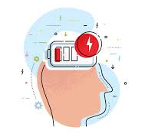
Difficult Emotions
10
At times, we can all experience difficult emotions. Many young people, with or without a health condition, experience feelings of low mood and anxiety. Low mood can be temporary, and pass within a couple of days or weeks, or it can last longer. It is sometimes referred to as depression, especially if it lasts longer than two weeks and starts to affect all areas of life.
What does low mood or depression feel like?
Depression can affect people very differently. Here is how some people feel:
Depressed (low) mood most of the day almost every day
Reduced interest or pleasure in activities some of the time
Significant weight loss or gain, or decrease/increase in appetite
A slowing down of thought and being less physically active (observable by others)
Fatigue or loss of energy most days
Feelings of worthlessness
Thoughts of/actually self-harming
Feeling that you don’t want to be here anymore
What does anxiety feel like?
Anxiety can affect people very differently. Here is how some people feel:
Stop enjoying normal life
Constantly worrying
Obsessively researching your health condition and complications
Avoiding any reminders of your health
Fatigue or loss of energy
Difficulty sleeping
Inability to relax
Unable to concentrate
Feeling constant ‘butterflies’ or a ‘lump’ in your throat
Heart beat racing
Often causes tummy ache/headaches
Take a moment to think about how you have been feeling lately. Some examples are below, and you can use the blank spaces to write other emotions that you are noticing.
1._______________________________
stressed
2._______________________________
Numb
Overwhelmed
Uncomfortable
Angry or frustrated
3._______________________________
Lonely

Slide 11
Difficult Emotions
11
Some people experiencing difficult emotions can get caught in an unhelpful cycle, resulting in them withdrawing from previously enjoyed activities, not managing their health condition, sleep disturbances, and isolation. It is important to recognise this cycle, so we can break it and begin enjoying life again. Below is an example of how our thoughts, feelings, body sensations and behaviours are all connected.
Situation
Who? What? Where? When? How?
e.g. A friend makes a rude comment about my condition (there is a lot of misunderstanding, and people can make unhelpful comments)
Thoughts
What went through my mind at the time?
e.g. I hate myself, I am useless
My friends don’t like me anymore
Behaviour
How did I respond to the current situation?
e.g. Overthinking
Avoiding seeing my friends
Stopped taking medication
Staying in my room/in bed
Not doing normal activities
Crying
Shouting
Emotions
What emotions did I feel at the time?
e.g. Sad, low, angry,
frustrated, lonely, embarrassed, scared, worried
Bodily sensations
What emotions did I notice in my body? What did I feel? Where did I feel it?
e.g. Tired, no energy,
heavy feeling in my chest,
heart racing

Slide 12
Difficult Thoughts
12
At each step of the cycle, there are things we can do to try and change things for the better
Situation
Think about how we respond. What will help?
Notice our thoughts and question them
Thoughts
Behaviour
Emotions
Regulate our bodily sensations through breathing/ mindfulness
Notice our emotions, accept they are valid and OK. Ride the emotion wave
Bodily sensations
Noticing any Unhelpful Thoughts:
When we are facing a stressful situation, it’s common for us to experience negative thoughts.
When you are living with a health condition you may have thoughts like:
My life is too hard.
I can’t cope with all of the things I have to do.
None of my friends can ever understand what I’m going through.
People will judge me because I look different to them.
I’ll never be able to live the life I want to.
Sometimes we need to allow ourselves permission to have these thoughts, and just notice they are there.
But we know that if our thoughts are negative a lot of the time, this may begin to impact how we are feeling, our bodily sensations and our behaviour and can make coping with our condition tricky.
Managing any Unhelpful Thoughts:
It’s important to remember, Thoughts are not Facts!
Thought Checker:
Am I thinking it’s going to be worse than it might actually be?
Am I trying to predict the future when I can’t really know for sure what will happen?
Am I forgetting to think of the positives in this situation?
Am I thinking in black-and-white terms, that things will either be good or bad with no in-between?
Am I thinking that just because I had one bad experience, it will definitely happen again?

Slide 13
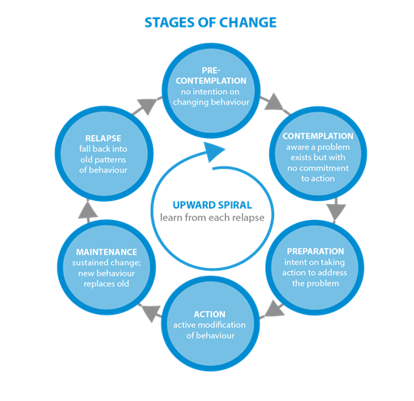
Motivation to Make a Change
13
Think of something you would like to change or are trying to change at the moment, about your relationship with your health condition. For example, it might be to eat a healthier meal in the evening, give your medication more consistently, or to increase the amount of exercise you do. Then look at the Stage of Change below: which stage are you in?
Often, we know what we need to do differently,
but it’s not always easy to actually do it, then maintain it.
To help you move through this cycle of change:
If you’re in the pre-contemplation stage now, maybe try to set aside some time to think about the pros and cons of making the change.
If you’re contemplating change, think about what the first step would be in taking action.
If you’re in the preparation stage now, commit to the time you will start to make the change.
If you’re in the action stage, well done! You’ve already started making positive changes. Now try to think of how you can maintain this in the longer-term; what needs to be in place to support you?
If you’re in the maintenance stage, well done! You have made a change and maintained it over time. If you stay here long enough, you will have achieved your goal and your new behaviour will become automatic for you. Try to think about anything that could tempt you to give up or lose motivation, and put a plan in place to prevent that.
If you’re in the relapse stage, well done for giving it a go. The key is to learn from this attempt at change and work out why it didn’t work out this time. Then set a new goal to work towards.

Slide 14
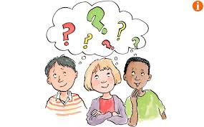
Burnout
14
If you have been living with your health condition for some time, you may at times feel fed-up with all the tasks you have to do to manage it. This feeling is often referred to as ‘burnout’. One sign of burnout is noticing a change in how you manage your condition; some common examples are below
On one hand I want to and on the other hand I don’t want to manage my condition
I notice I am missing appointments or worried about going to the hospital
I am exhausted with managing it all the time
I am finding I am avoiding some parts of my treatment, more often
I feel like my condition is controlling me at the moment and not the other way around!
I am feeling sad or worried about my health at the moment.
I am feeling alone with my health care at the moment. I am arguing more about it with my family.
To Manage Burnout:
- Notice the signs when burnout is bothering you: Everyone can experience burnout differently: what are your early warning signs?
- Be kind to yourself: No one can be perfect all the time so if you have a day when you don’t hit your treatment goals, remind yourself that you can start again tomorrow. Remember it is normal to have good and bad days.
- Book in something to look forward to: prioritise doing the activities that you enjoy
- Celebrate your Sparkling Moments: No matter how small they are. Write down what has gone well, even if it is nothing to do with your health condition or only lasted for a couple of minutes.
- Focus on solutions not problems: To get back on track with your treatment, set small goals and take one step at a time. What made this one small positive step possible?
- Share the Load: Can a family member help you “take a break” from the constant need to pay attention to your health and take a few hours off? Are there tasks they could do for you, for now?
- Ask for Help: Burnout loves making people feel like they are isolated - so don’t let it win! Find someone you trust to talk about how you are feeling. Family and friends can provide an ear to vent how you are feeling or to help champion your goals. Tell the medical team too; they might have practical ideas about how to ease the burden for you by reviewing your management plan.

Slide 15
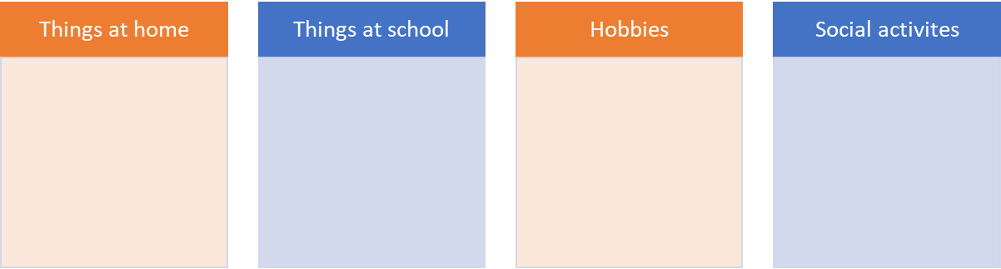
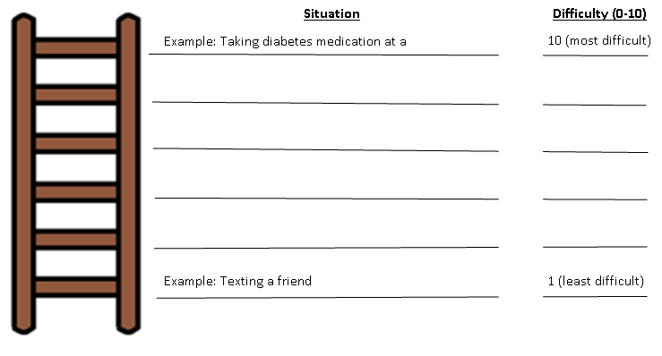
How can I Improve my Wellbeing?
15
The good news is a lot of the ideas you’ve likely already discussed in clinic to help you manage your health condition will also help you to feel better about yourself. For example, eating healthily, exercising and ensuring you get enough rest/sleep, will all help you to feel better emotionally as well as physically.
When difficult emotions stop us from doing things that we used to enjoy, this can make us feel even worse in the long-term. Take a moment to think about the things you have stopped doing or are doing less, because of your feelings around your health condition. Try making a note below of things you are avoiding:
The next step is to plan how easy it would be to start doing some of these activities again. Create a ladder (hierarchy) of tasks with the most difficult at the top and easiest at the bottom. Then you can start by trying to complete the easiest task. Before you complete each task, write down what you think will happen, then once you’ve completed the task write down what actually happened. Hopefully you will start to see that it is mostly not as bad as you think it is going to be. If a task feels too difficult try to break it down into smaller, more manageable, tasks. Approach this step by step, don’t try to complete all tasks at once.
Giving an injection at a sleepover

Slide 16
How can I Improve my Wellbeing?
16
We might need different strategies to manage our emotions at different times. Here are some things to try:
Let It Out Physically
Scream as loud as you can.
Hit a pillow.
Squeeze a stress ball.
Play loud music and dance energetically, be as wild as you like!
Go for a brisk walk/swim/bike ride/running.
Work out how you’re feeling
Ask yourself: do I feel angry? anxious? Low? Numb? What is making me feel like this? What triggered this feeling?
Try drawing or writing down your feelings, or talking to somebody
Creativity as a way of expression
Draw/paint/use any artistic medium to produce a piece of art depicting how you are feeling.
Write a poem/ story/ song/ joke/ musical about how you are feeling.
Play an instrument/sing as loud as you can.
Put on music which expresses how you are feeling.
Comforting yourself
Have a warm bubble bath or shower.
Stroke a pet/cuddly teddy.
Cuddle a friend/family member.
Practice yoga and meditation.
Write a list of your achievements
Make a list of things you’re thankful for
Distract yourself
Watch TV/movies.
Play on a computer/phone/tablet
Do puzzles/games
Do arts & crafts.
Learn a new skill (e.g. juggling/ speaking another language/drawing).
Playing with brother/sister/friend/pet
Getting out and about
Take the dog for a walk
Ride your bike
Help parents with tasks around the house
Go for a walk and try to notice all the different colours and sounds around you
Mindfulness
Mindfulness is about paying attention on purpose, and simply noticing what is happening right now. Mindfulness is taking notice of how your body feels, what you see, smell and taste.
Mindfulness can be a group, 1:1, or individual activity. You can practice mindfulness anywhere you feel comfortable. There are many benefits to becoming more ‘mindful’ and accepting of your thoughts and feelings.
For more information on mindfulness, have a look at https://www.mind.org.uk/information-support/drugs-and-treatments/mindfulness/about-mindfulness/
Being Productive
Catch up on chores and homework.
Cook/bake something
Have a clear out – donate your old clothes and toys to charity.
Rearrange your room.
Volunteer somewhere.
Think about what you would like to change about your life and make a plan.

Slide 17
Coping with my Health Condition
17
Avoidant coping is when you try to ignore or escape from challenges, you try to pretend that they aren’t happening.
Secondary coping is when you adapt to the stressor and change the way you respond to its challenges
Primary coping is when you tackle the source of your challenges to change your stress, through problem-solving.
There are three main ways of coping. Do you recognise yourself in these examples?
The Problem with Avoidant Coping
If something feels difficult, sometimes we try to avoid thinking about it. But then we never fully understand the problem enough to be able to solve it, and the difficult feeling remains. If we avoid our difficulties then when we come to relax at night, our brains suddenly want to remind us of all the things we need to worry about and it can be difficult to get to sleep. On the other hand, sometimes when things feel difficult, we can overthink things and it can spiral to the point where we feel worse. This applies to everyone, however when you have a health condition there are additional things to think about, therefore we can easily end up in a spiral of overthinking.
Instead, it can be helpful to get a good balance between avoiding and overthinking, by setting a designated ‘worry time’ during the day. To set this up:
Create a set worry time (should be no longer than 10-15 minutes).
  What time works best? When you’re home from school? Ideally not just before bed.
Postpone overthinking/worries
  When a worrying or stressful thought appears during the day remind yourself ‘I don’t need to worry about this now, I can worry about it later’
  Make a brief note of thoughts if you’re worried you’ll forget, then do something to distract yourself
Complete worry time at agreed time, for up to 15 minutes
  Maybe write down your worries? Or talk to a parent or friend? Or draw how you’ve been feeling?
  You might want to spend the time exploring your feelings, or problem-solving some solutions
  It is important that we allow ourselves to explore feelings but not think about them all day.

Slide 18


Contents: Guided Self Help Worksheets
18
The following pages give other ideas for coping with difficult emotions and thoughts. This is a summary of how they might help
Calming The Body - Feeling relaxed can help reduce symptom severity
Progressive Muscle Relaxation (PMR)…………………………………….……………………………(See p.19)
Muscle tension is commonly associated with stress and anxiety, it is the body's natural response to potentially dangerous situations. Even when there is no danger, our bodies can still respond in the same way. You may not always realise that your muscles are tense, it may be as subtle as your jaw clenching, or as obvious as your shoulders feeling really tight and hunched. PGR is a deep relaxation technique which is based upon the simple practice of tensing one muscle group at a time . This is followed by a relaxation phase with release of tension. This is very useful before bedtime.
Deep Breathing.…………………………………………………………………………………………….....….(See p.20)
During deep breathing your blood is oxygenated, triggering the release of endorphins, whilst also decreasing the release of stress hormones, and slowing down your heart rate.
Calming The Mind - Strategies for managing anxiety and stress
Worry Tree…………………………………….…………………………………………..…………………………(See p.21)
Worry Trees are helpful in reducing levels of anxiety surrounding both hypothetical situations and current problems.
Visualisation………………………………………………………..………………………………………...….…(see p.22)
Help yourself to feel more relaxed by thinking about things that make you feel calm and rested. For example, picturing your favourite place. This can be either independent, or you can take a guided visualisation approach. A guided visual imagery relaxation task has been provided in this pack.
Safe Place Visualisation……………………………..……………………………………………….…………(see p.23)
A powerful stress reduction and relaxation tool, that can be applied at any time, in any location.
Self-Soothing Strategies…………………………………………………………………………………….…(see p. 24)
This is a useful technique for remaining grounded in the present, to alleviate symptoms of stress and anxiety.
Developing Coping-Self Talk…………………………………………..…………………………………....(see p.25)
These are phrases that you can say to yourself that are supportive. For example “Just because it has happened before it does not mean it will happen again”

Slide 19















Progressive Muscle Relaxation
Get comfortable in a distraction free environment. You can either lay down or sit upright in a chair. Closing your eyes will help you focus on the different muscle groups, but you do not have to if you don’t want to! For all steps, hold the tense position for a couple of deep breaths, or however long is comfortable for you, then relax. Repeat each step three times.
Draw a deep breath in through your nose and feel your abdomen rise as you fill your body with air. Then slowly exhale from your mouth, pulling your belly-button towards your spine.
Start with your feet. Clench your toes with your heel pressing towards the ground. Squeeze tightly for a couple of breaths and then release. It may help to say ‘relax’ whilst you release the tension. Next, flex your feet with your toes pointing towards your head.
Next move to your legs. Stretch your leg out, with your toes pointing towards the sky, feel the back of your leg tightening. Hold this for a couple of deep breaths and then release. Then, point your toes down into the ground with your leg straight for a couple of deep breaths.
Now move onto your glutes. Squeeze your buttocks muscles for a couple of deep breaths. Remember, you should only feel tension and not pain.
To tense your stomach and chest, pull your belly button in towards your naval as tight as you can. Breath in deeply, filling up your chest and lungs with air.
Next, tense your shoulder blades and back. Push your shoulder blades backwards, as if you are trying to get them to touch. This will push your chest forwards.
Now tense the muscles in your shoulders as you bring your shoulders up towards your ears.
Be careful when tensing your neck muscles! Face forward, and SLOWLY pull your head back to look up at the ceiling.
Squeeze your teeth together to tense your jaw. Open your mouth as wide as you can, as if you are yawning, to relax your mouth and jaw.
To tense your eyes and cheeks, squeeze your eyes tight shut.
Raise your eyebrows as high as they will go, as if you were surprised, to tense your forehead.
To tense your upper arms, bring your forearms up to your shoulder to ‘make a muscle’.
Finally, to tense your hand and forearm, make fists with both of your hands.
Practice means progress. Only through practice can you become more aware of how your muscles respond to tensions and relaxation. Training your body to respond differently to stress is like any training – practice is the key!

Slide 20

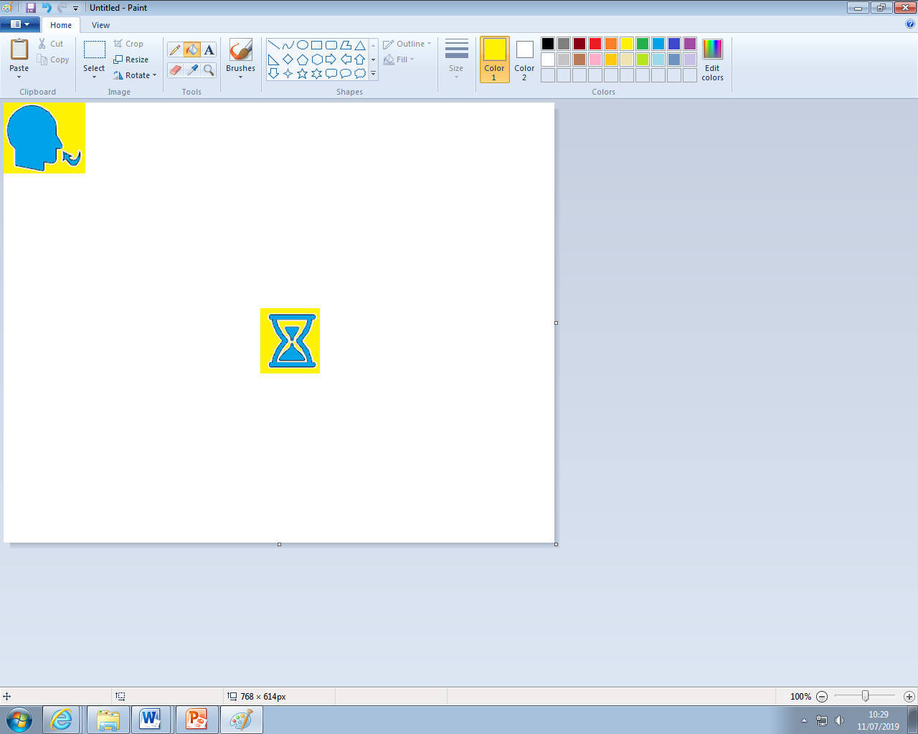
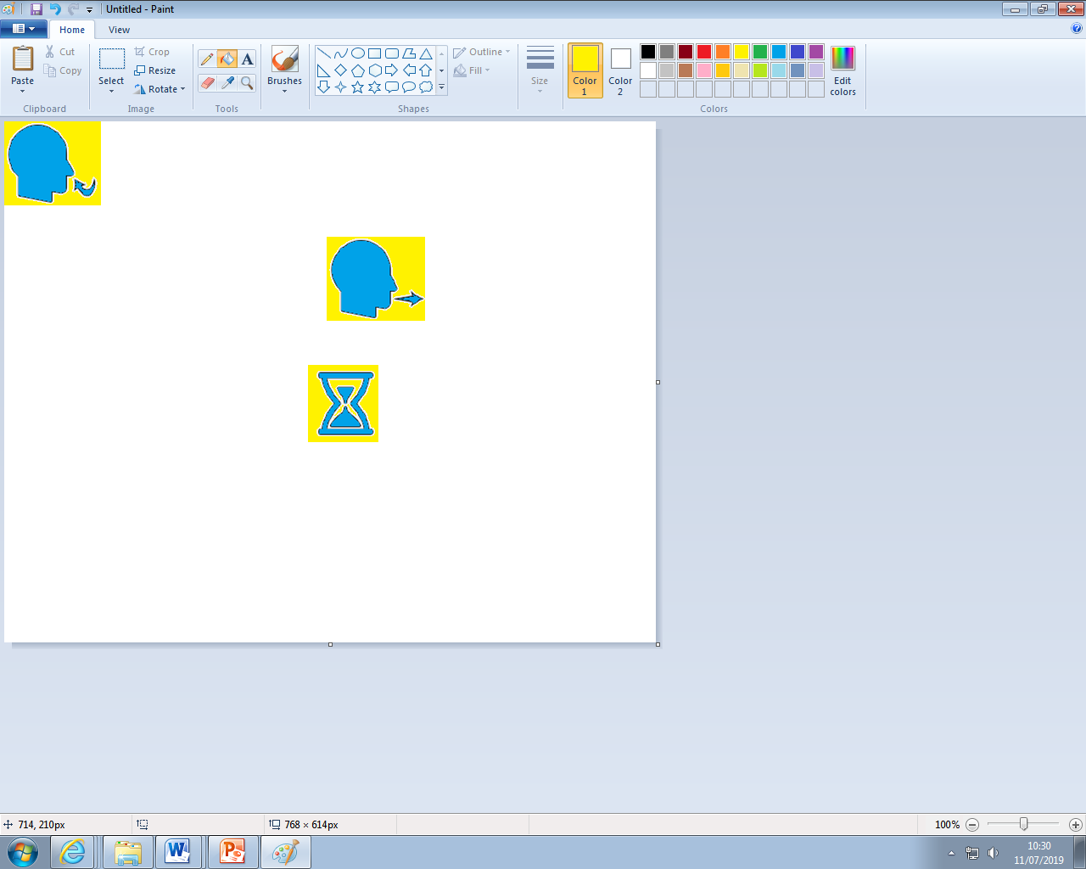
Calming The Body:
Deep Breathing
During periods of anxiety, the body triggers the Fight or Flight Response. Breathing is shallow, uncontrolled, and muscles become tense. Deep breathing triggers the Relaxation Response, whereby breathing becomes deeper, controlled, slower, and the symptoms of anxiety reduce.
Sit or lie down comfortably. Close your eyes if it makes you feel more comfortable. Place your hand on your stomach, if you breath deeply enough, you should notice your hand rising and falling with each inhalation and exhalation. Imagine a balloon blowing up in your stomach as you breath in, and deflating as you breath out.
1. Inhale. Breath in slowly through your nose for 4-8 seconds.
2. Pause. Hold the air in your lungs for 4-8 seconds (however long is most comfortable for you).
3. Exhale. Breath out slowly through your mouth for 4-8 seconds.
Repeat. Practice for at least 2 minutes. As your technique improves, practice for 5-10 minutes.
Tips
Slow down. The most common mistake is breathing too quickly. Count each step slowly as you do so.
Counting your breaths takes your mind off of the source of anxiety. Counting acts as a distraction, whenever you catch your mind wandering, return to counting.

Slide 21






Worry Tree
21
1. What is making you worry?
________________________________________________________________________________________________________________________________________________________________________________
2. Can I do anything about this issue?
NO
YES
Try to distract myself to ease my worry
Make a mind-map or list showing what different things I can do to stop or improve my worry.
3. Can I do anything about it right now?
Yes, I can…
____________________________________________________________________
No, I cannot do anything about it in this moment.
Make a mind-map or action plan of what I can do in the future to help ease my worry.
Do this now!
Stop worrying and distract yourself.
Do my best to stop worrying by distracting myself, until I can action my plan.
Tip: make your mind-maps and lists colourful, you will be more likely to remember what you have written, and engage with the material more!

Slide 22

Guided Visual Imagery Relaxation: The Beach
Lay down, or sit comfortably in a quiet room. Use the deep breathing techniques you learnt earlier in this pack, close your eyes and listen to somebody read you the following script. You can also read this script to yourself. You may find it more relaxing to play an audio track of crashing waves on the beach; this can be sourced on YouTube, Spotify, and most other online music platforms.
You’re walking down a long wooden stairway to a big, beautiful beach. It is very quiet and stretches off into the distance as far as you can see. As you look down you notice that the sunlight is reflecting off of the golden sand. You step into the sand, it feels warm so you wriggle your toes. You notice the warmth from the sand between your toes and around your feet. You notice the sounds of the waves crashing and chasing you up the shore, the water sparkles like a diamond as it retreats back. The roaring sound of the waves is so soothing that you can just let go of any worries.
The ocean is a beautiful light blue, with patches of darker sapphire in the deep. As you look at these deep blue areas you notice a small sailboat on the horizon. All of these sights help you to let go of any worries and relax even more.
As you continue walking along the beach, you become aware of the fresh salty sea air. You look up take a slow deep breath in, and breath out. This breath makes you feel refreshed and relaxed. As you look up you notice two seagulls, the wind gusts and they appear to dance in graceful circles above you. It makes you wonder how it would feel if you could fly under the warm sun.
You find yourself settling into a deep state of relaxation as you walk further down the beach. You feel the sun wrap its warm arms around you, the warmth relaxes all of your muscles. You notice a beach chair as you walk down the beach, once you reach it you take a seat. Laying back in this comfortable chair makes you reflect on everything you have felt, seen and thought at this beach. You drift into a deeper state of relaxation.
Now, feeling relaxed and at peace, you slowly rise from the beach chair and step into the warm sand to walk home. As you walk, you remember how relaxing this beach has been, and you know that you can come back to this place anytime you like. You start to climb the wooden stairs and gradually bring yourself back into the room. When you are ready, you can open your eyes.

Slide 23
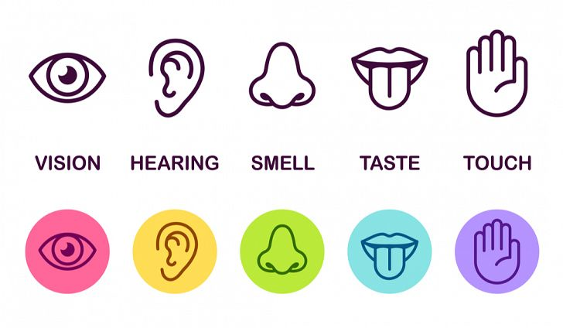
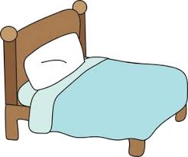
Relaxing Safe Place Imagery
23
All visualisations can be strengthened by engaging all of your senses in creating your ‘Safe Place’. If you any negative thoughts enter your positive imagery, discard that image and create another one.
Get comfortable in a quiet place where you won’t be disturbed. Sit, or lie, comfortably. Take a few minutes to practice some deep breathing, become aware of any tension in your body, and release it with each breath.
Imagine a place where you can feel safe and relaxed. Your safe place can be somewhere you have been on holiday, somewhere you have seen a picture of, or a completely new place you create. Avoid using your home as your safe place.
Look around your safe place, pay attention all the colours and shapes around you. Describe what you see aloud.
Now focus on what you can hear. Listen to the sounds far away from you, and those close to you. Perhaps you hear is silence. You may hear the sound of running water, or the crunch of leaves under your feet.
Now focus on any skin sensations. Notice the feel of the ground beneath your feet, or whatever is supporting you in this place. Pay attention to the temperature and direction of the wind, and anything else you can feel.
Take a deep breath in. Place your hand on your stomach, and imagine a balloon inflating in your stomach. Can you notice any smells there? Maybe you can taste the salty sea air as you inhale?
Pay attention to all of these sensations whilst you spend time relaxing in your safe place.
Whilst you’re in your safe place, give it a name that you can use to bring that image back at any time.
You can choose to stay for a while, enjoying the calmness and tranquillity. You can leave when you are ready by slowly opening your eyes and bringing yourself back to alertness in the present.

Slide 24





24
Self-Soothing
5, 4, 3, 2, 1 Grounding Technique
This approach explores your five senses to help keep you grounded in the present. This is a calming technique that can help you get through periods of anxiety, or headaches. It can be done independently, making it useful for when you are alone.
Take a deep belly breath to begin. Imagine a balloon in your stomach filling up with air as you breath in.
LOOK: Look around for 5 things that you can see, and say them out loud. For example, you could say, I see the TV, I see the pencil case, I see a vase of flowers.
FEEL: Pay attention to your body and think of 4 things that you can feel, and say them out loud. For example, you could say, I feel my feet warm in my slippers, I feel the grass beneath my feet, or I feel the beanbag I am sitting on.
LISTEN: Listen for 3 sounds. It could be the sound of traffic outside, the sound of typing or the sound of your tummy rumbling. Say the three things out loud.
SMELL: Say 2 things you can smell. If you’re allowed to, it’s okay to move to another spot and sniff something. If you can’t smell anything at the moment or you can’t move, then name your 2 favourite smells. You may say, I can smell dinner cooking, or I can smell perfume.
TASTE: Say 1 thing you can taste. It may be the toothpaste from brushing your teeth, or sweetness from fruit. If you can’t taste anything, then say your favourite thing to taste.
Take another deep belly breath to end.

Slide 25

Develop Coping Thoughts/
Positive Self-Talk
Positive statement encourage us and help us cope in distressing times. We can act as our own coach by saying encouraging things to ourselves, especially when our symptoms are worse (e.g. pain). Creating a sentence that you can say to yourself when you are feeling low or struggling to cope with your health condition can be very useful. Some children keep a copy of these in their pencil case or wallet so that they are always available.
Some examples include:
“I can do this.”
“I can cope.”
“Keep calm and carry on.”
“Thoughts are just thoughts – they are not necessarily fact.”
“It is okay to feel this way, it is a normal reaction.”
“This is difficult and painful, but it is only temporary.”
“This won’t last forever.”
Activity:
Fill in the empty spaces with a coping thought you could use in this situation:
Situation | Coping Thought/Positive Statement
Example: I have got really bad stomach pain, I am supposed to have a test at school today. | ‘The pain will pass, like it has done before. I can still go and do my best, and talk to a teacher to tell them about how I am feeling’.
I was supposed to go out with my friends today, I’m too tired today.
I keep missing out on taking part in sports.

Slide 26
For Parents: Supporting Young Children and Teenagers
Living With a Long-Term Health Condition
It can be difficult to see a child/teenager struggling. However, as an adult there are ways in which you can help improve their ability to manage their condition.
Set Routine and Record – It is important that the young person establishes a routine to ensure they get enough sleep, but also so they can live a balanced life where their energy is dedicated to family time and hobbies, as well as schoolwork. Keeping a diary can really help with this as it allows you and your child to ensure they have periods of rest, away from thinking about their health condition. You can find an activity, rest and sleep diary using this link - https://www.ruh.nhs.uk/patients/services/clinical_depts/paediatric_cfs_me/documents/CFSActivityRestSleepdiary.pdf
Distract and reduce focus on physical symptoms - It can be difficult to know how to respond to a child/ young adult who is experiencing symptoms such as pain, tiredness or lacking motivation to look after their health. Often, the natural urge is to pay attention to signs that the young person may be struggling. It is important to avoid making the child/ young person worry or become anxious, as they may focus on their symptoms more. Although it is challenging as a parent, it is important to minimise attention on the symptoms, for example, by not constantly asking how tired they are.
Encourage normal activities – It is important that the young person continues to participate in activities they enjoy, rather than dedicating all their energy to schoolwork. These activities may need to be adapted or managed differently with their health condition, and the temptation is to avoid them because it becomes too much effort. But it’s important to feel part of a social group and do things they enjoy, with peers. It will get easier to manage with practice!
Provide encouragement – Children and young people will feel more confident in their ability to cope with their health condition with your support and confidence. Your role is to provide positive encouragement that they can cope with and manage it.
Support and communicate – Health conditions may affect your child/teenager’s ability to attend school, complete homework, coursework and revision. Offering support with studies may relieve some of the stress and give them more space to prioritise their health. You may like to provide this information booklet to their school/college so they can provide extra support where necessary.
Access you own support if you need it – coping can be difficult for the whole family, not just the person with the health condition. You can talk to your GP about services that might be able to support you if you are finding it difficult to manage.
26

Slide 27
Accessing further Support
27
27
For Managing Diabetes:
Digibete 19-25’s page –
https://www.digibete.org/digibete-16plus/19-25s/
Diabetes UK Podcast - https://www.diabetes.org.uk/guide-to-diabetes/podcasts
Diabetes and your emotions - https://www.diabetes.org.uk/guide-to-diabetes/emotions
Diabetes UK Youth programme - https://www.diabetes.org.uk/how_we_help/community/youth-programme
JDRF diabetes and emotional wellbeing - https://jdrf.org.uk/information-support/living-with-type-1-diabetes/health-and-wellness/emotional-wellbeing/
Various diabetes and emotions guides - https://www.diabetes.co.uk/emotions/
10 tips for coping with diabetes distress - https://www.cdc.gov/diabetes/managing/diabetes-distress/ten-tips-coping-diabetes-distress.html
Managing diabetes-related stress video - https://www.youtube.com/watch?v=ZQwGKEa_MkM
Your feelings about diabetes technology - Your feelings about diabetes technology | Diahttps://www.diabetes.org.uk/guide-to-diabetes/diabetes-technology/diabetes-technology-emotionsetes UK
Your feelings about food and diabetes - https://www.diabetes.org.uk/guide-to-diabetes/emotions/your-feelings-about-food-and-diabetes
What is diabetes burnout? - https://www.diabetes.org.uk/guide-to-diabetes/emotions/diabetes-burnout
Dealing with diabetes burnout - https://www.cdc.gov/diabetes/library/spotlights/diabetes-burnout.html
Diabetes UK Helpline: 0345 123 2399
Epilepsy Action Helpline: 0808 800 5050
For Managing Epilepsy:
Online support for young people with Epilepsy: https://www.youngepilepsy.org.uk/i-have-epilepsy
Child-friendly resources on Epilepsy: https://www.epilepsy.org.uk/living/parents-and-children/just-for-kids
For parents: supporting your child with Epilepsy: https://www.epilepsy.org.uk/living/parents-and-children
Epilepsy Society Helpline: 01494 601 400

Slide 28
Accessing further Support
28
28
For Managing Asthma
Resources for children and young people with Asthma: https://www.beatasthma.co.uk/resources/young-people-with-asthma/
Advise on managing asthma when studying, during puberty and when leaving home: https://www.asthmaandlung.org.uk/conditions/asthma/manage/asthma-young-people
Help for young people on living independently with asthma: https://movingonasthma.org.uk/
Asthma & Lung UK Helpline: 0300 222 5800
For Managing Allergies
Online courses, meet ups and information on managing allergies: https://theallergyteam.com/support-and-events/
Youth Engagement Project: https://www.allergyuk.org/youth-engagement/
Information for parents on managing residential trips, sports, etc: https://www.allergyuk.org/living-with-an-allergy/parent-pathways/5-11/youth-activities/
Allergy UK Helpline: 01322 619 898
For Managing Cystic Fibrosis
Accessing yoga classes and funds to support activities:
https://www.cfkids.org.uk/
Youth programme, online events, resources and information for young people: https://www.cysticfibrosis.org.uk/get-involved/cf-youth
Cystic Fibrosis Trust Helpline: 0300 373 1000
Generic Useful Websites
Mental health resources for Teachers, Parents, Carers & Children: http://www.youngminds.org.uk/
Stress and Anxiety: https://www.moodcafe.co.uk/for-children-and-young-people/feeling-worried,-frightened,-stressed-or-anxious.aspx
Anxiety and Depression: https://www.nhs.uk/conditions/stress-anxiety-depression/anxiety-in-children/
Mindful Breathing and Activities: www.getselfhelp.co.uk/mindfulness.htm
Relaxation Techniques: www.getselfhelp.co.uk/relax.htm
Thought Distancing: www.getselfhelp.co.uk/cbtsetp6.htm
Supporting Sleep: www.getselfhelp.co.uk/sleep.htm
If you are having suicidal thoughts call 116 123 (open 24 Hrs) or text SHOUT to 85258

Slide 29

Local Free Youth Counselling and Mental Health Services:
Berkshire
Number 22
*must be aged between 12-25 and live in Windsor, Maidenhead or Slough*
27 Church Street, Slough, SL1 1PL
Tel: 01628 636661
Email: info@number22.org
Self Referral Link:
https://number22.org/enquiry-form/
Bookable telephone appointment:
https://number22.org/support22/
Time to Talk
*Must be aged 11-25 year old living in West Berkshire.*
Free counselling sessions. Face-to-face, online or telephone sessions.
Broadway House, 4-8 The Broadway, Newbury, RG14 2BA
Tel: 01635 760 331
Email: office@t2twb.org
Self Referral Link:
https://t2twb.counsel360.co.uk/referral/create
Kooth
Free, online counselling:
https://www.kooth.com/
Child and Adolescent Mental Health Service (CAHMS)
*Must be age 0-17 and living in Berkshire*.
For more serious concerns about your child's mental health.
Tel: 0300 365 1234 (for non-urgent enquiries)
For urgent mental health concerns about a young person: Call the mental health access team on 0300 247 0000.
Link to Refer: https://forms.berkshirehealthcare.nhs.uk/cypf/
Youthline
*Must be aged 12-25 and live in Bracknell Forest.*
Counselling sessions in person, online and by telephone.
7 Portman Close, Bracknell, RG42 1NE
Tel: 01344 311200
Email: ask@youthlineuk.com
Self Referral Link:
https://www.youthlineuk.com/counselling-enquiry
ARC Youth Counselling
*must be aged 11+ and living in Wokingham*
Counselling sessions face-to-face or online.
35 Reading Road, Wokingham, RG41 1EG.
Tel: 0118 977 6710
Email: Office@arcweb.org.uk
Self Referral Link:
https://arcweb.org.uk/get-in-touch/
Berkshire Talking Therapies
*must be aged 17+ and living in Berkshire*
Talking therapy for anxiety, low mood & stress.
Tel: 0300 365 2000
Email: talkingtherapies@berkshire.nhs.uk
Self Referral Link:
https://gateway.mayden.co.uk/referral-v2/7c824928-ff62-4838-855e-80d1281dfb94
Developed by Jessica Stacey (Undergraduate Assistant Psychologist) and Dr Hayley Thompson (Principal Clinical Psychologist)

Slide 30
Local free Youth Counselling and Mental Health Services:
Buckinghamshire
Bucks Mind
*Must be aged 13-21 and live in Buckinghamshire*
Face-to-face and online appointments.
Tel: 01494 463364.
Email: ypcounselling@bucksmind.org.uk
Referral Link:
https://www.bucksmind.org.uk/young-peoples-counselling-referral-form/
Youth Concern
*must be aged between 13-25 and live in Aylesbury Vale, Buckinghamshire*
Offer 20 free counselling sessions face-to-face, by phone or virtual.
The Uptown Coffee Bar, Whitehill Lane, Aylesbury, HP19 8FL.
Tel: 01296 431183
Text or Whatsapp: 07470 833500
Email: admin@youthconcern.org.uk
Youth Enquiry Service (YES Wycombe)​​
*Must be aged between 13-35 and live in High Wycombe*​
​
52 Frogmoor, High Wycombe, HP13 5DG​
Tel: 01494 437373 ​
Email: info@yeswycombe.org​
​
Referral Link:​
https://www.yeswycombe.org/get-in-touch
Kooth
Free, online counselling: https://www.kooth.com/
Child and Adolescent Mental Health Service (CAHMS)
*Must be age 0-17 and living in Buckinghamshire*.
For more serious concerns about your child's mental health.
Tel: 01865 901 951
Email: BucksCAMHSSPA@oxfordhealth.nhs.uk
Link to Refer: https://secureforms.oxfordhealth.nhs.uk/camhs/Buckinghamshire.aspx
The Mix
*Must be aged 11-25 and live in the UK*
Telephone or webchat counselling.
Mental Health Innovations, PO Box 78319, London, W10 9FE
Contact Link:
https://www.themix.org.uk/about-us/contact-us
Self Referral Link:
https://themix.my.salesforce-sites.com/CounsellingBooking
Buckinghamshire Talking Therapies
*must be aged 17+ and living in Buckinghamshire*
Talking therapy for anxiety and depression.
Tel: 01865 901 600
Text: Text TALK and your name to - 07798 667 169
Self Referral Link:
https://www.iaptportal.co.uk/ServiceUser/SelfReferralForm.aspx?sd=eb19256a-1304-4192-bbc3-56aab5e1c7c6
Developed by Jessica Stacey (Undergraduate Assistant Psychologist) and Dr Hayley Thompson (Principal Clinical Psychologist)

