Slide 1
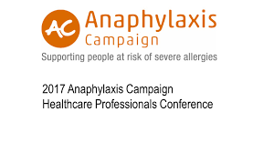
Paediatric Food Allergy Overview & Pitfalls of Testing
Dr Lindsay Exell
Wexham Park Hospital
13th July 2022

Slide 2
Team of 3 senior doctors running personal clinics (Quadri / Exell / Oliver)
Allergy Nurse (Jaymee Gordon)
Skin-prick testing
BSACI allergy action plans
AAI Device training
Specific IgE testing and component resolved diagnostics
Hospital Based Oral Food Challenge service (OFC)
Limited numbers and available only to children within Wexham allergy clinic
Strong connections with WANG
Future developments
Peanut Immunotherapy maintenance
Pollen and House dust mite immunotherapy
Overview of Wexham Park Paediatric Allergy Service

Slide 3
What sort of food allergies do we see?
Immediate IgE food allergies – MAIN FOCUS
Delayed non-IgE food allergies- often managed in general POPD
FPIES- uncommon, frequently missed
Oral Allergy Syndrome
Related Atopic Problems, e.g.
early severe eczema
good asthma care (cofactor for risk)

Slide 4
>30% of parents believe their child has food allergy
6-8% actually do
Poor understanding of true IgE food allergy and unrelated conditions such as dietary intolerance to non-food proteins such as lactose / IBS/ histamine intolerance
Fixed belief that all eczema is caused by food allergy (It’s not)
Parents value/trust tests even though these are often not indicated and counterproductive
Testing has (at best) limited value and provides high level of false positives which reinforces beliefs and is hard to unravel
Psychological bias once results known
Fear of risk re early introduction over estimated
Delayed introduction of key allergens increases the risk of food allergies developing
Onslaught of private companies offering inappropriate testing, often with no evidence base to susceptible families
Actual severity reaction versus visually-perceived severity
Parenting Pitfalls

Slide 5
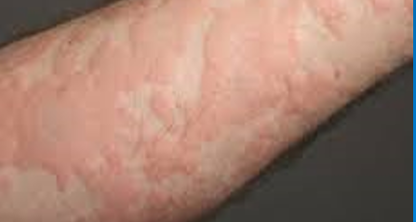
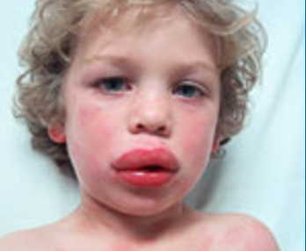
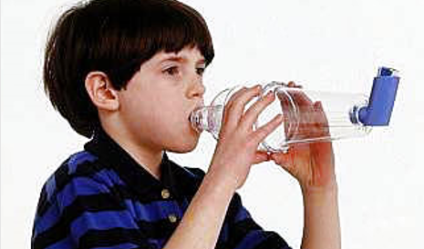
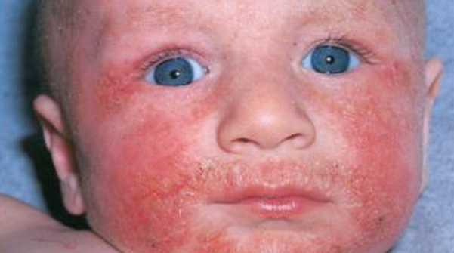

Slide 6
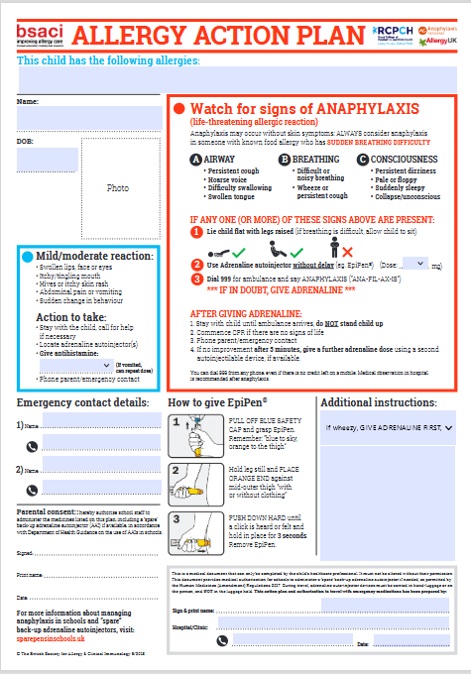
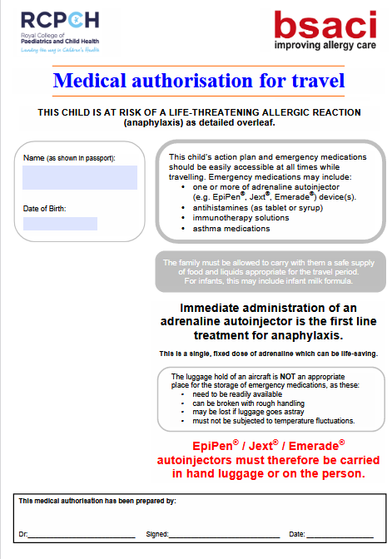

Slide 7
IgE Food Allergy
14 major allergens
Milk -baked forms tolerated first, most will resolve in childhood, but a small percentage can have lifelong high risk allergy (single highest cause of fatal anaphylaxis)
Egg- 80% tolerate baked egg from the outset which supports tolerance ( introduce baked first)
Peanuts, tree nuts and sesame-20% early allergy can resolve but most become lifelong with associated risk of further allergies developing due to delayed introduction
Lentils/chickpeas- can be common but less risk or LTE
Wheat- not common ( tests terrible)
Soy – often associated with milk/PFS
Fish and shellfish
Oral allergy /PR10 crossover with implications for late onset symptoms to certain nuts
(mustard/celery/lupin/sulphites)

Slide 8
Not IgE food allergens
Fruits generally in early childhood
Contact fruit acid irritation
Tomato based foods (fruit acid and histamine-like chemicals)
Foods high in histamines/histamine-like compounds “histamine intolerance”-can cause allergy-like symptoms of flushing,itchiness, d/v, abdo pain>/=30minutes after meals
Smoked foods/tinned fish /cheeses/tomatoes/aubergine/spinach and nuts
Random foods
Non typical foods such as rice/maize and barley
Unhealthy foods (slush puppies/brain licker etc - genuine recent referrals)
Foods that flare eczema several hours later (potentially non IgE)
Itchiness at mealtimes when eczema bad-usually just driven by flared eczema which needs improved treatment

Slide 9
IgE Food Allergy Diagnosis
EATERS History – Cornerstone of diagnosis and of more value than testing
E– Exposure
A– Allergen
T – Timing
E – Environment
R – Reproducibility
S – Signs and Symptoms

Slide 10
E– Exposure
A– Allergen
T – Timing
E – Environment
R – Reproducibility
S – Signs and Symptoms
Eating or skin contact
Major food allergens
Usually within minutes and certainly one hour of eating food protein
Parties, restaurants, takeaways & high chair weaning (first exposure)
Reacts every time to same food protein
Urticaria, swelling, vomiting and ABC symptoms

Slide 11
Value of Testing
Limited! (If in doubt – don’t)
Not required to make diagnosis which is EATERS based
May help in clinic to assess emerging tolerance
May be useful to assess co-factor allergens pre-introduction
Can be helpful when food contains combined ingredients
Mixed nuts
Hummous -(chickpea/sesame)
Pesto- (dairy/cashew/ pine-nut)
Excellent for oral allergy/Pollen Food Syndrome (CRD)
To determine when to consider an OFC in hospital or when to advise home introduction

Slide 12
Who has read this?-appears on ICE results
Text from hospital test result
No other test on ICE starts with this type of statement
ALLERGEN GRADE INTERPRETATION
 | Allergen Comment
Specific IgE results must be interpreted in the context of the clinical history. A positive allergen-specific IgE does not equate to clinical allergy and conversely, negative results do not exclude clinical allergy. Requesting clinicians are welcome to discuss the results with Immunology/Allergy team or refer to an Allergy clinic.

Slide 13
Value of food allergy testing
Only has good negative predictive value (NPV) and positive predictive value (PPV) for certain foods
 | NPV | Grey Area | PPV
SPT (mm) | 0 | >0 but <6 | >/=8 (>6 infants)
SIgE | <0.35 | 0.35 – 14.9 | >/=15
NPV – predicts 95% of children would tolerate the food on exposure (however 5% will still react)
PPV – predicts 95% of children would react on exposure to food (however 5% will still tolerate)
Grey Area – who knows?!
False positive testing particularly common in bad eczema due to high circulating IgE
interpretation often impossible
Increases anxiety and food AVOIDANCE ( even when well tolerated)
Increases risk of of food allergy
LEAP STUDY

Slide 14
Take Home Messages – DO NOTs
Never do SIgE testing for eczema alone or urticaria unrelated to eating
Only test for specific foods for which there is a clear history of IgE symptoms
Never tell families to stop eating nuts/foods that are already tolerated
Avoid blanket exclusion diets
Don’t believe tests are needed in order to make a referral
Don’t believe tests predict severity of reactions
Understand inappropriate panel testing is a modern day Pandora’s Box of Evil

Slide 15
Take Home Messages - DOs
Use EATER's framework to support /exclude diagnosis
Resist testing at parents’ request in absence of clear history and refer to us instead if necessary
Signpost parents to recommended early weaning with common allergens supported by BSACI early weaning advice
Consider Pros and Cons of delays to introduction incurred by referring for tests first
Encourage baked egg as early weaning food (If child then reacts to loose egg they can continue eating baked)
Encourage the milk ladder from 11 months in delayed milk allergy – actual treatment supporting tolerance acquisition
( we also use cautiously with mild IgE type)
Refer for opinion or ask advice
if not sure

Slide 16
1-2 year reviews
Establish evolving tolerance (milk and egg)
Assess accidental ingestions and management
Review new foods tolerated/ avoiding
Adherence to safety and compliance
Assess family understanding of management of acute reactions
Parents for younger children
Teenagers with emerging independence
Co-factors and risk-taking behaviour
Parachute analogy
Sink analogy
Discussion of future treatments ( immunotherapy)
Typical Follow-up in Outpatients

Slide 17
The only thing which predicts reduced likelihood of death from anaphylaxis is previous admission to ITU with anaphylaxis
Food allergy continues to increase
Anaphylaxis incidence is increasing significantly year on year
Anaphylaxis is increasing in younger children
Nothing predicts risk of anaphylaxis accurately
In 50% of cases of Anaphylaxis, the previous reaction was mild
Level of SPT/SIgE does not predict severity of reactions
More people eat in at risk environments / convenience foods
Hidden nuts increasingly being used in vegan / vegetarian foods as protein substitute
Why so much Adrenaline?
Actual versus perceived risk: More likely to die driving to and from allergy appointment than from the food allergy itself
(when UK food allergy deaths are static at 10-12 per year)

Slide 18
Parachute Analogy
If you were told one day you were likely to need to jump from a plane and you were offered a parachute would you want one?
Which flights would you take it on
Long Haul only
When travelling with parents
If you thought riskier flight
Or you might not bother as most flights should be fine
Always- as you never know when
If you were told you had to jump would you have:
Checked parachute in to hold
Left in under your seat
Make sure you had it on your back
Once you have jumped would you:
Count til 5 and you were a safe distance from the plane and then deploy parachute to give it time to slow you down
Would you wait til the last minute and use only then when it might be too late

Slide 19
Sink Analogy
If an allergic reaction is like leaving the taps running in the sink
Antihistamines only pull the plug out
ONLY adrenaline can turn off the taps
If the taps are on full blast only adrenaline will stop the sink overflowing

Slide 20
Familiar excuses for not using AAI
Antihistamine worked last time ( may not “get away” with it next time)
Didn’t think I/they were bad enough ( AAI works best on early ABC symptoms)
Didn’t want to have to call 999 and go to hospital
Didn’t think I was going to be eating ( other causes of exposure )
I have eaten it before and it was ok ( recipes can change and manufacturers only need to update ingredients
Thought I would try my Ventolin first
I didn’t want to cause a fuss/ I was embarrassed
I thought I would feel better if I could just get outside on my own
My reactions are normally mild

