Slide 1


Soiling and Constipation Resource Pack
Paediatric Psychology Services
Wexham Park Hospital
Produced by:
Maria Langridge, Assistant Psychologist
Dr. Lara Payne, Clinical Psychologist
Dr. Jenny Cropper, Clinical Psychologist
1
Developed by: Maria Langridge, Assistant Psychologist, Dr Lara Payne, Clinical Psychologist, and Dr Jenny Cropper, Clinical Psychologist.
A special thank you to Michael White, whose work has been adapted (p.11) for the purpose of this pack.

Slide 2
Contents
How Does The Bowel Work?..…………….........………….See p. 3
Bristol Stool Form Scale.…………………….………………….See p. 4
Constipation……………………….………………………..……….See p. 5
Soiling…..…………………………….…………….…………………..See p. 6
The Constipation Cycle……………………..…………………..See p. 7
Physiological Support..………………………………….……….See p. 8
Information For Parents, Carers, And Teachers…………………………………………………………..…..See p. 9
Beating Sneaky Poo: The Comic ………………..………..See p. 11
Reward Chart……………………………………………………….See p.12
Contents: Guided Self Help Worksheets……………………………………..………………….See p. 13
Calming The Body…………………………………….………….See p. 14
Calming The Mind……………………………………….………See p. 16
Online Support…………………………………………………….See p. 20
Local Support..…………………………………………………….See p. 21
Developed by: Maria Langridge, Assistant Psychologist, Dr Lara Payne, Clinical Psychologist, and Dr Jenny Cropper, Clinical Psychologist.

Slide 3
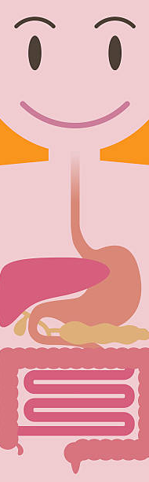
How Does the Bowel Work?
3
In order to explain the different problems that can occur in toileting, it helps to understand how the bowel works.
1. Food Goes Into The Mouth
When we eat food, we first chew it into small pieces making it more manageable to swallow.
2. Chewed Food Goes Into The Stomach
When the chewed up food enters the stomach, the food is mashed up to the point of a ‘soupy’ mixture.
3. Soupy Food Mixture Goes Into The Small Intestine
Here, the nutrients are taken out of the soupy food mixture, and used by the rest of the body.
4. Waste Is Produced
The waste liquid, watery poo, then travels down into the large intestine. The large intestine has strong muscles which push the food mixture along. The body absorbs water as the food mixture is pushed along, turning it into the soft, smooth, sausage shaped poo you recognise.
5. Poo Reaches The Rectum
When the poo reaches the rectum, the lowest part of the bowel, it stretches and a message is sent to the brain that you need to do a poo.
Developed by: Maria Langridge, Assistant Psychologist, Dr Lara Payne, Clinical Psychologist, and Dr Jenny Cropper, Clinical Psychologist.

Slide 4
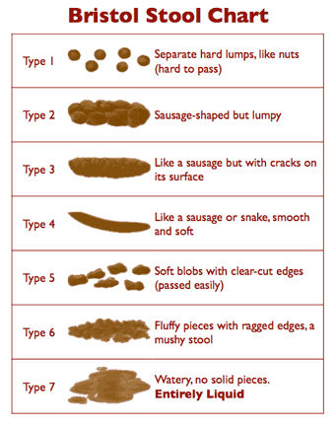
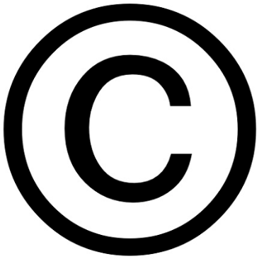
What does your poo look like? Bristol Stool Form Scale
4
‘Stool’ and ‘bowel movement’ are just other words for poo!
Reproduced from Dr KW Heaton, formerly Reader in Medicine at the University of Bristol.
Heaton, K W & Lewis, S J 1997, 'Stool form scale as a useful guide to intestinal transit time'. Scandinavian Journal of Gastroenterology, vol.32, no.9, pp.920 - 924.
Developed by: Maria Langridge, Assistant Psychologist, Dr Lara Payne, Clinical Psychologist, and Dr Jenny Cropper, Clinical Psychologist.

Slide 5
Constipation
5
What is ‘constipation’?
Constipation is described as the inability to poo regularly, or to completely empty the bowel. Someone may be constipated if they do fewer than four poos in a week. Type 1 and 2 stools on the Bristol Stool Form Scale indicate constipation.
What causes constipation?
There are many causes of constipation, including:
Unhealthy Diet. Diets lacking in water and fibre mean the bowels do not move as they should. A healthier diet that includes high fibre foods (fruits, vegetables, and wholegrains) prevent poo from becoming hard and dry. People with diets high in processed foods, cheeses, white breads and meats may find they become constipated more often.
Not enough exercise. Moving around helps food to travel down the digestive system; not getting enough physical activity can contribute towards constipation.
Stress. Some may find they become constipated when they are stressed or anxious. Stress can impact how the digestive system works, resulting in constipation, or the opposite, diarrhoea.
Fear of the toilet. This can also be associated with pain or discomfort when passing stools.
Irritable Bowel Syndrome (IBS). IBS can cause either constipation or diarrhoea, as well as stomach pain and gas.
Withholding poo. Avoiding the toilet, even when you have the urge to go, can cause constipation. Ignoring the urge can make it harder to go to the toilet later on.
Medication. Some medication, like those used to treat iron deficiencies, can lead to constipation.
What are the signs and symptoms of constipation?
Different people have different bathroom habits; someone who doesn’t do a poo every day is not necessarily constipated. Some people may have bowel movements three times a day, whereas others may only have one every 2 days. However, if you are going less than normal, or you are finding it painful to poo, you may be constipated. A person with constipation might:
Feel full and bloated
Experience pain when attempting to poo
Have to strain to do a poo
Stomach aches, with occasional nausea.
Developed by: Maria Langridge, Assistant Psychologist, Dr Lara Payne, Clinical Psychologist, and Dr Jenny Cropper, Clinical Psychologist.

Slide 6
Soiling
6
What is soiling?
Soiling happens when poo comes out in underwear, on the floor, or in other inappropriate places. For younger children this may be because they are still learning to recognise when they need to go. However, some individuals may have a more regular and persistent difficulty.
What causes soiling?
Constipation. Constipation is the most common cause of soiling. When you do not have regular bowel movements, the bowel can become loaded with large stools which are hard to pass. This is sometimes referred to as ‘faecal impaction’. Soiling occurs when runny poo leaks around the hard lump that is blocking the way; or if there has been a longstanding problem of constipation and the lower bowel and rectum have become overstretched and de-sensitised. Soiling can happen several times a day as the child does not always receive the message that they need a poo, or is not always aware that the poo has come out.
Withholding poo. This can be due to fear of the toilet, which can be associated with pain or discomfort.
Lack of a toilet routine. Some children and young adults have such busy lives that it can be difficult to find time to sit and relax on the toilet each day. Some children may not want to interrupt play or other activities.
Resistance to toilet training. This may be an insistence that a nappy be put on to poo in.
Diet. Too little fibre or low fluid intake in the diet.
Anxiety and emotional upset. Anxiety may be caused by any significant changes, including changes in routine.
In many children there is likely to be a combination of several of these factors.
Signs and symptoms of soiling
Soiling can affect people in different ways. You may have a problem if:
You have sudden urges to poo that you cannot control
There is leakage or liquid poo in your underwear
You are constipated, with dry and hard poos
You avoid bowel movements
There are long periods of time between doing poos
You have a lack of appetite
You experience abdominal (tummy) pain
You are increasingly getting bladder infections
It is affecting your daily life. For example, stopping you from socialising with friends.
Developed by: Maria Langridge, Assistant Psychologist, Dr Lara Payne, Clinical Psychologist, and Dr Jenny Cropper, Clinical Psychologist.

Slide 7
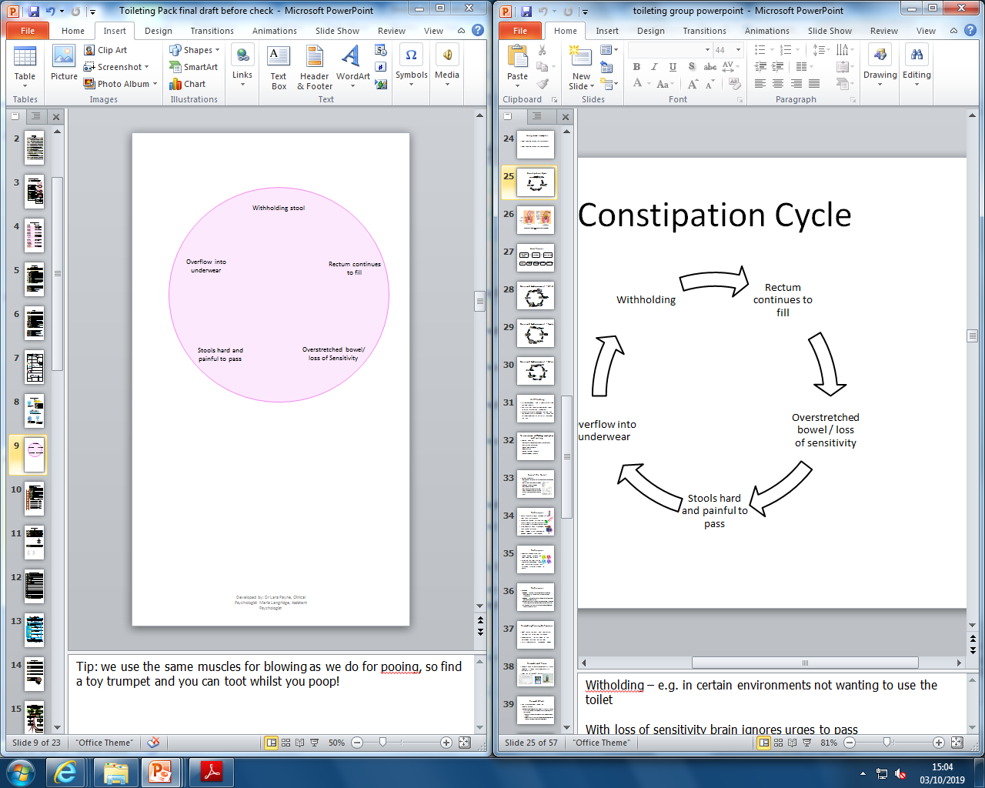
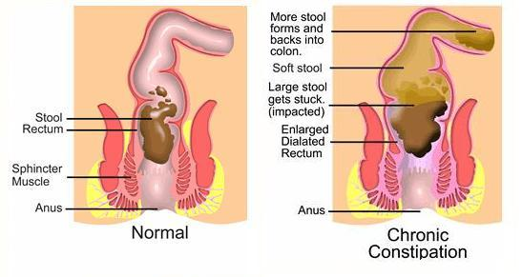
The Constipation Cycle
7
A child may withhold their stool due to a fear of using the toilet, pain when passing a stool, or simply because they do not like using the toilet in certain environments.
The rectum continues to fill, causing the muscles in the rectum to get stretched. When the stretched muscles try to tighten, they cannot do so very well. The muscles have got out of shape! The signallers in your bowel are like telephone lines; they send a message to the brain when you are ready to do a poo. These signallers also become stretched when the rectum gets full up, making it difficult to do their job effectively. The good news is that you can train these stretch signals to be strong again!
Withholding stool
Overflow into underwear
Rectum continues to fill
Stools hard and painful to pass
Overstretched bowel/ loss of sensitivity
With a loss of sensitivity and an overstretched bowel, the brain ignores the urge to do a poo. The poo sits in the bowel, where much of the water is absorbed from it. This makes the poo hard and painful to pass, and therefore children are naturally more likely to withhold poo.
Over time, liquid poo can start to leak around the dry, hard, and impacted stool, making attempts at withholding even more likely.
The constipation cycle explains how soiling develops, and how it continues.
The really important parts to remember are that:
Children have no control over this process
It is no-one's fault
Developed by: Maria Langridge, Assistant Psychologist, Dr Lara Payne, Clinical Psychologist, and Dr Jenny Cropper, Clinical Psychologist.

Slide 8




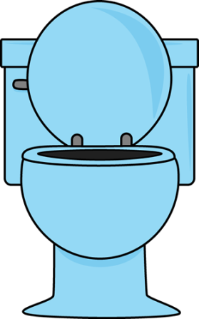

Physiological Support
8
Your GP may advise you to take ‘Movicol’ or ‘Laxatives’.
Movicol is a powder that comes in sachets that you mix with water. Laxatives are also a medicine used to treat constipation. Children and young adults who are eating solid foods may be prescribed laxatives to help reduce constipation.
It is important to eat a diet high in fibre, fruit, and vegetables e.g. whole wheat products (like brown rice and pasta), peas, broccoli, carrots, sweetcorn and oranges, apples,
Tip: Add more vegetables to soups and stews, have baked and boiled potatoes and keep the skins on, swap white bread for brown bread.
Drink lots of fluids, at least 6-8 cups!
Exercise stimulates the bowel, so exercise just before the toilet routine can be helpful.
Give the recommended amount of milk for the child’s age. Too much milk can have a constipating effect on some children.
Regular toilet routine: sit on the toilet for 5-10 minutes everyday after breakfast and evening meals.
Developed by: Maria Langridge, Assistant Psychologist, Dr Lara Payne, Clinical Psychologist, and Dr Jenny Cropper, Clinical Psychologist.

Slide 9



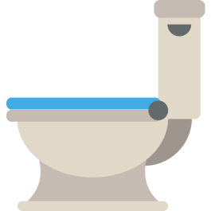
Information for Parents/Carers and Teachers
9
Toilet Routine
Implement a regular toilet routine for your child/young adult. You can use a toilet reward chart in conjunction with a toilet routine to encourage your child to use the toilet. There are natural times for using the toilet, such as after meals. Encourage your to sit on the toilet several times a day; the most important times are after breakfast, after school, and after dinner for 5-10 minutes a time (if they open the bowels before this time period ends, they can leave the toilet after). Tip: we use the same muscles for blowing as we do for pooing, so find some bubbles or a toy trumpet and you can get blowing whilst you use the toilet!
Be Positive and Encouraging
Evidence of your support, encouragement, and understanding will help your child to relax and eventually move forward in their journey to overcoming soiling, constipation, and withholding. Your support and understanding is VITAL – they can do it if you think they can.
Normalise The Toilet
It is important to talk openly and honestly about going to the toilet.
The ‘Lets Talk About Poo’ campaign aims to raise awareness of children’s toileting problems among parents, health professionals and educators so that we all know how to identify when a child may be struggling with toileting, and so we can comfortably talk about it. This allows those close to the child to intervene at an early stage with simple measures to help them poo.
Allowing your child to observe normal toileting behaviour, such as seeing parents use the toilet frequently, shows the child that the toilet does not need to be feared.
‘Toilet Area’
Sometimes it is necessary to build up confidence to sit on the toilet and relax before the child can comfortably open their bowels on the toilet. Suggest that children who insist on using a nappy to poo do so in the toilet area. Adopt a gradual exposure approach; encourage the child to sit on the toilet with the nappy on, and over time gradually remove it. It is important to create an environment without anxiety and pressure.
Developed by: Maria Langridge, Assistant Psychologist, Dr Lara Payne, Clinical Psychologist, and Dr Jenny Cropper, Clinical Psychologist.

Slide 10
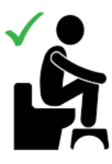
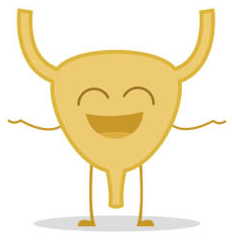


10
Child Friendly Space
You can help reduce strain by giving your child a low foot stool to put their feet on when doing a poo. Foot stools encourage children to adopt a squatting position, which encourages the pelvic floor muscles to relax. This in turn reduces the amount of strain necessary to pass a bowel movement.
Comfort is important, feet should be able to touch the floor/stool to help pushing. Sitting on the toilet can be reinforced by providing children with interesting activities, such as reading a book or completing a Rubik’s Cube or similar puzzle.
Promote a Healthy Bladder
Whatever level of continence your child is going to achieve, promoting a healthy bladder and bowel is vital. Untreated constipation can lead to frequent, loose bowel actions which can cause sore skin. A full bowel occupies the space the bladder needs, resulting in frequent, small wees and a big risk of Urinary Tract Infection (UTI). All children need to drink plenty of fluids, to avoid constipation, and should have their wees and poos monitored.
Rewarding/Praising Behaviours
Set an initial goal . This initial goal should not be too difficult, it needs to be achievable by the child. For example, sitting on the toilet for 5 minutes. Offer extra reward/praise for opening bowels during this period. Reward charts can be set up to help with this goal (see page 12 for an example). It is best to have only 1-2 target behaviours at any time.
Rewards should be appropriate and reasonable, such as a sticker, or a small treat like 10 minutes on the iPod. You can tailor rewards and reward charts based on your child’s interests. The sooner praise/reward are given after the target behaviour, the faster learning occurs. All members implementing this must be consistent in their application of the system, parents, wider family, and school staff.
Parents and anyone else working with the child should be careful to create a facilitative environment to support with soiling and constipation.
This environment should send the message that:
The child is loved and respected regardless of any toileting difficulties. They are offered praise and encouragement for progress, no matter how small the progress is.
Soiling is a problem which is non-intentional and experienced by the child as uncontrollable. The child should not be scolded or punished for a lack of bowel control.
Parents believe the child has great courage for coping with soiling. Children will be encouraged if you have faith that they have the ability to learn bowel control by jointly working with the parent and healthcare providers.
Developed by: Maria Langridge, Assistant Psychologist, Dr Lara Payne, Clinical Psychologist, and Dr Jenny Cropper, Clinical Psychologist.

Slide 11
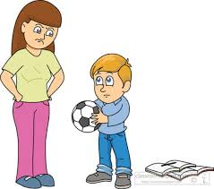
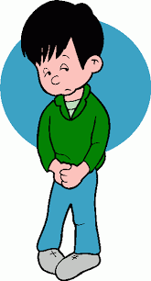
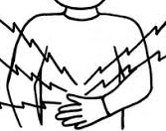

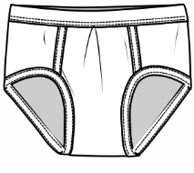

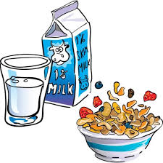
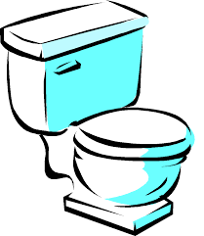

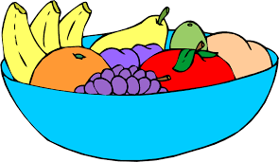
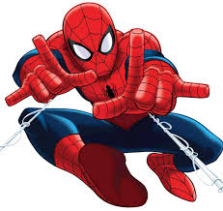

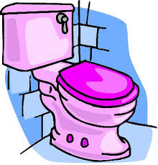
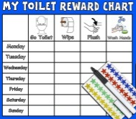

The Sneaky Poo Comic: Beating Sneaky Poo
11
Special acknowledgements to Michael White. Work adapted from ‘Beating Sneaky Poo’ leaflet published by Dulwich Centre Publications ©(available online)
Joe feels upset because people are blaming him.
Joe’s friends have been saying he smells, but Sneaky Poo is the smelly one! Joe’s parents have been getting upset when Sneaky Poo makes a mess in Joe’s underwear. Everybody blames Joe, but Sneaky Poo never gets into trouble. Joe decides he wants to get back in charge of Sneaky Poo!
This is Joe. Joe is upset with Sneaky Poo for causing trouble, and for stopping him from doing things that he likes to do.
Sneaky Poo loves to play hiding games. His favourite hiding places are in Joes stomach, and his underwear!
Joe knows that he will beat Sneaky Poo with lots of practice!
Joe starts eating a healthy diet high in fibre, with lots of fruit and vegetables. He also starts to drink a lot more water.
Joe is working on improving the signals from his bottom that tell him Sneaky Poo is about to arrive. He does this by eating a big breakfast, waiting 20 minutes, and then sitting on the toilet. Joe knows it is important to practice everyday otherwise Sneaky Poo will keep playing hiding games in Joe’s stomach and pants.
Joe wants some help getting back in charge of Sneaky Poo. He decides that Spiderman is going to help him. He puts a picture of Spiderman up in the toilet to remind him that Spiderman is supporting him to be in charge of Sneaky Poo. Who would help you to take control over Sneaky Poo? It could be a superhero, an animal, or anyone you would like! You can draw a picture of your supporter on the right, and write what they might say to you to help take charge.
Tip: You could time yourself to see how quickly you can go to the toilet and try to beat your time.
Joe plans his quickest routes to the toilet at home and school. He knows that Sneaky Poo can arrive quickly sometimes!
Joe sets up a chart, which he ticks each time he uses the toilet routine he planned, and also for every time he manages to keep Sneaky Poo from out of his pants and only in the toilet. Joe begins taking more control over Sneaky Poo.
Joe has a new friend – Captain Poo! Unlike Sneaky Poo, Captain Poo tells Joe when it is time to go to the toilet, and helps Joe avoid anymore accidents.
Developed by: Maria Langridge, Assistant Psychologist, Dr Lara Payne, Clinical Psychologist, and Dr Jenny Cropper, Clinical Psychologist.

Slide 12
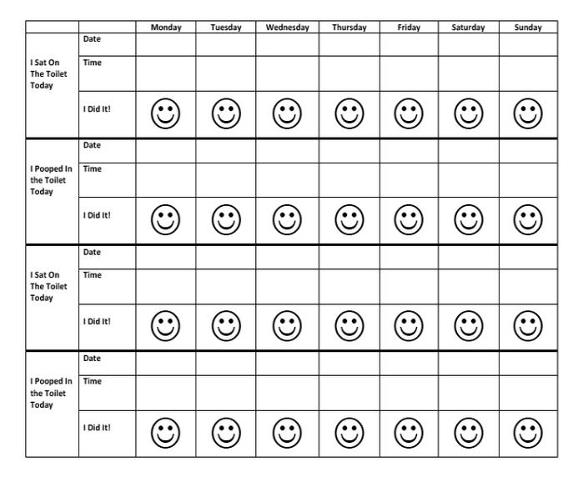



12
Reward Chart
Colour in the smiley faces, the date, and time of each goal achieved.
Tip: Above is an example of a toileting reward chat. These charts are more fun and beneficial if you design it with the child, and tailor it based on what they like . For example, you could design a reward chat with a theme of ‘Paw Patrol’, or ‘Marvel’.
Developed by: Maria Langridge, Assistant Psychologist, Dr Lara Payne, Clinical Psychologist, and Dr Jenny Cropper, Clinical Psychologist.

Slide 13
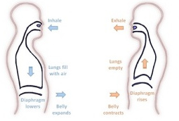


Contents: Guided Self Help Worksheets
13
Calming The Body - Feeling relaxed helps when trying to pass a poo!
Progressive Muscle Relaxation (PMR)………………………………………………………(See p.16)
Muscle tension is commonly associated with stress and anxiety, it is the bodies natural response to potentially dangerous situations. Even when there is no danger, our bodies can still respond in the same way. You may not always realise that your muscles are tense, it may be as subtle as your jaw clenching, or as obvious as your shoulders feeling really tight and hunched. PGR is a deep relaxation technique which is based upon the simple practice of tensing one muscle group at a time . This is followed by a relaxation phase with release of tension. This is very useful before bedtime.
Deep Breathing.……………………………………………………………………………….....….(See p.17)
During deep breathing your blood is oxygenated, triggering the release of endorphins, whilst also decreasing the release of stress hormones, and slowing down your heart rate.
Calming The Mind - Strategies for managing the anxiety
and stress that is often associated with soiling and constipation
Visualisation…………………………………………………………………………………...….…(see p.17)
Help yourself to feel more relaxed by thinking about things that make you feel calm and rested. For example, picturing your favourite place. This can be either independent, or you can take a guided visualisation approach. A guided visual imagery relaxation task has been provided in this pack.
Safe Place Visualisation……………………………………………………………………………(see p.18)
A powerful stress reduction and relaxation tool, that can be applied at any time, in any location.
The Ladder Hierarchy……………………………………………………………………………….(See p.19)
Help yourself to change how you cope with toileting difficulties, by gradually exposing yourself to different toileting scenarios over time.
Developing Coping-Self Talk…………………………………………..……………………....(see p.20)
These are phrases that you can say to yourself that are supportive. For example “Just because it has happened before it does not mean it will happen again”
Developed by: Maria Langridge, Assistant Psychologist, Dr Lara Payne, Clinical Psychologist, and Dr Jenny Cropper, Clinical Psychologist.

Slide 14















Progressive Muscle Relaxation
14
Get comfortable in a distraction free environment. You can either lay down or sit upright in a chair. Closing your eyes will help you focus on the different muscle groups, but you do not have to if you don’t want to! For all steps, hold the tense position for a couple of deep breaths, or however long is comfortable for you, then relax. Repeat each step three times.
Draw a deep breath in through your nose and feel your abdomen rise as you fill your body with air. Then slowly exhale from your mouth, pulling your belly-button towards your spine.
Start with your feet. Clench your toes with your heel pressing towards the ground. Squeeze tightly for a couple of breaths and then release. It may help to say ‘relax’ whilst you release the tension. Next, flex your feet with your toes pointing towards your head.
Next move to your legs. Stretch your leg out, with your toes pointing towards the sky, feel the back of your leg tightening. Hold this for a couple of deep breaths and then release. Then, point your toes down into the ground with your leg straight for a couple of deep breaths.
Now move onto your glutes. Squeeze your buttocks muscles for a couple of deep breaths. Remember, you should only feel tension and not pain.
To tense your stomach and chest, pull your belly button in towards your naval as tight as you can. Breath in deeply, filling up your chest and lungs with air.
Next, tense your shoulder blades and back. Push your shoulder blades backwards, as if you are trying to get them to touch. This will push your chest forwards.
Now tense the muscles in your shoulders as you bring your shoulders up towards your ears.
Be careful when tensing your neck muscles! Face forward, and SLOWLY pull your head back to look up at the ceiling.
Open your mouth as wide as you can, as if you are yawning, to tense your mouth and jaw.
To tense your eyes and cheeks, squeeze your eyes tight shut.
Raise your eyebrows as high as they will go, as if you were surprised, to tense your forehead.
To tense your upper arms, bring your forearms up to your shoulder to ‘make a muscle’.
Finally, to tense your hand and forearm, make fists with both of your hands.
Practice means progress. Only through practice can you become more aware of how your muscles respond to tensions and relaxation. Training your body to respond differently to stress is like any training – practice is the key!
Developed by: Maria Langridge, Assistant Psychologist, Dr Lara Payne, Clinical Psychologist, and Dr Jenny Cropper, Clinical Psychologist.

Slide 15
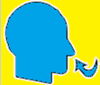
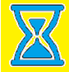
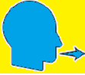
Calming The Body: Deep Breathing
15
During periods of anxiety, the body triggers the Fight or Flight Response. Breathing is shallow, uncontrolled, and muscles become tense. Deep breathing triggers the Relaxation Response, whereby breathing becomes deeper, controlled, slower, and the symptoms of anxiety reduce.
Sit or lie down comfortably. Close your eyes if it makes you feel more comfortable. Place your hand on your stomach, if you breath deeply enough, you should notice your hand rising and falling with each inhalation and exhalation. Imagine a balloon blowing up in your stomach as you breath in, and deflating as you breath out.
1. Inhale. Breath in slowly through your nose for 4-8 seconds.
2. Pause. Hold the air in your lungs for 4-8 seconds (however long is most comfortable for you).
3. Exhale. Breath out slowly through your mouth for 4-8 seconds.
Repeat. Practice for at least 2 minutes. As your technique improves, practice for 5-10 minutes.
Tips
Slow down. The most common mistake is breathing too quickly. Count each step slowly as you do so.
Counting your breaths takes your mind off of the source of anxiety. Counting acts as a distraction, whenever you catch your mind wandering, return to counting.
Developed by: Maria Langridge, Assistant Psychologist, Dr Lara Payne, Clinical Psychologist, and Dr Jenny Cropper, Clinical Psychologist.

Slide 16

Guided Visual Imagery Relaxation: The Beach
Lay down, or sit comfortably in a quiet room. Use the deep breathing techniques you learnt earlier in this pack, close your eyes and listen to somebody read you the following script. You can also read this script to yourself. You may find it more relaxing to play an audio track of crashing waves on the beach; this can be sourced on YouTube, Spotify, and most other online music platforms.
You’re walking down a long wooden stairway to a big, beautiful beach. It is very quiet and stretches off into the distance as far as you can see. As you look down you notice that the sunlight is reflecting off of the golden sand. You step into the sand, it feels warm so you wriggle your toes. You notice the warmth from the sand between your toes and around your feet. You notice the sounds of the waves crashing and chasing you up the shore, the water sparkles like a diamond as it retreats back. The roaring sound of the waves is so soothing that you can just let go of any worries.
The ocean is a beautiful light blue, with patches of darker sapphire in the deep. As you look at these deep blue areas you notice a small sailboat on the horizon. All of these sights help you to let go of any worries and relax even more.
As you continue walking along the beach, you become aware of the fresh salty sea air. You look up take a slow deep breath in, and breath out. This breath makes you feel refreshed and relaxed. As you look up you notice two seagulls, the wind gusts and they appear to dance in graceful circles above you. It makes you wonder how it would feel if you could fly under the warm sun.
You find yourself settling into a deep state of relaxation as you walk further down the beach. You feel the sun wrap its warm arms around you, the warmth relaxes all of your muscles. You notice a beach chair as you walk down the beach, once you reach it you take a seat. Laying back in this comfortable chair makes you reflect on everything you have felt, seen and thought at this beach. You drift into a deeper state of relaxation.
Now, feeling relaxed and at peace, you slowly rise from the beach chair and step into the warm sand to walk home. As you walk, you remember how relaxing this beach has been, and you know that you can come back to this place anytime you like. You start to climb the wooden stairs and gradually bring yourself back into the room. When you are ready, you can open your eyes.
16
Developed by: Maria Langridge, Assistant Psychologist, Dr Lara Payne, Clinical Psychologist, and Dr Jenny Cropper, Clinical Psychologist.

Slide 17
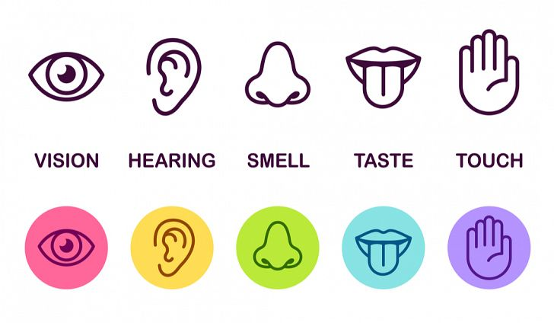
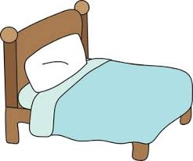
Relaxing Safe Place Imagery
17
All visualisations can be strengthened by engaging all of your senses in creating your ‘Safe Place’. If you any negative thoughts enter your positive imagery, discard that image and create another one.
Get comfortable in a quiet place where you won’t be disturbed. Sit, or lie, comfortably. Take a few minutes to practice some deep breathing, become aware of any tension in your body, and release it with each breath.
Imagine a place where you can feel safe and relaxed. Your safe place can be somewhere you have been on holiday, somewhere you have seen a picture of, or a completely new place you create. Avoid using your home as your safe place.
Look around your safe place, pay attention all the colours and shapes around you. Describe what you see aloud.
Now focus on what you can hear. Listen to the sounds far away from you, and those close to you. Perhaps you hear is silence. You may hear the sound of running water, or the crunch of leaves under your feet.
Now focus on any skin sensations. Notice the feel of the ground beneath your feet, or whatever is supporting you in this place. Pay attention to the temperature and direction of the wind, and anything else you can feel.
Take a deep breath in. Place your hand on your stomach, and imagine a balloon inflating in your stomach. Can you notice any smells there? Maybe you can taste the salty sea air as you inhale?
Pay attention to all of these sensations whilst you spend time relaxing in your safe place.
Whilst you’re in your safe place, give it a name that you can use to bring that image back at any time.
You can choose to stay for a while, enjoying the calmness and tranquillity. You can leave when you are ready by slowly opening your eyes and bringing yourself back to alertness in the present.
Developed by: Maria Langridge, Assistant Psychologist, Dr Lara Payne, Clinical Psychologist, and Dr Jenny Cropper, Clinical Psychologist.

Slide 18
Changing How I Cope With Toileting Difficulties:
The Ladder Hierarchy
18
Toileting difficulties can prevent us from doing things we like, such as going to the cinema, swimming, or spending time with friends. However, you cannot let these difficulties stop you! Ultimately, you need to face your fears if you want to overcome your anxiety around toileting. It may seem overwhelming in the beginning, however, it is much easier if you break the process down into smaller steps.
Construct a ladder of places or situations that you avoid because of anxiety around your toileting difficulties. At the top of the ladder, state the situation that you are most anxious about. At the bottom of the ladder, put places or situations you avoid , but don’t bother you as much. Give each item a rating of 0-10 according to how anxiety provoking the situation is.
Overcome the anxiety caused by your toileting problems by approaching these situations, starting from the bottom of the ladder. Make sure you write down what you think will happen, before approaching the task, and compare this with what actually happened.
Situation Anxiety (0-10)
Example: Doing a poo in a public toilet
10
Example: Sitting on my own toilet at home
4
Developed by: Maria Langridge, Assistant Psychologist, Dr Lara Payne, Clinical Psychologist, and Dr Jenny Cropper, Clinical Psychologist.

Slide 19

Develop Coping Thoughts/Positive Self-Talk
Positive statement encourage us and help us cope through distressing times. We can use these statements to replace the negative thoughts we experience during these distressing times. We can act as our own coach by saying these encouraging thigs to ourselves. Some examples include:
19
“I can do this.”
“I can cope.”
“Keep calm and carry on.”
“Thoughts are just thoughts – they are not necessarily fact.”
“It is okay to feel this way, it is a normal reaction.”
“This is difficult and painful, but it is only temporary.”
“This wont last forever.”
Activity:
Situation | Coping Thought/Positive Statement
Example: I have started in a new school. I do not know anybody here yet. I am worried about soiling myself around them. | It is okay, I have spare clothes and wet-wipes so I can clean myself up. It is normal to worry about this situation, but I know I can resolve it quickly and quietly.
I have exams in the next couple of weeks, they are really important. I am worried I will miss an exam, or do badly in them, because my tummy hurts.
My friend has invited people over to her house for a sleep over. I am scared I will have an accident.
I am starting a new school. I do not know where the toilets are, and I am worried I will not find them when I need them.
Developed by: Maria Langridge, Assistant Psychologist, Dr Lara Payne, Clinical Psychologist, and Dr Jenny Cropper, Clinical Psychologist.

Slide 20
Online Support
20
Apps:
Mindfulness and Sleep:https://www.smilingmind.com.au/
Meditation and Sleep:https://www.calm.com/
Meditation: https://www.headspace.com/kids
Progressive Muscle Relaxation: https://www.thinkpacifica.com/
Websites:
ERIC, the Bladder and Bowel Charity website:
https://www.eric.org.uk/
There is a free downloadable Guide to Children’s Bowel Problems. ERIC have also created Poo and Wee characters and a range of videos for children and parents.
Let’s Talk About Poo: http://web.archive.org/web/20161008172049/http://letstalkaboutpoo.eric.org.uk:80/about-the-campaign/
Bladder and Bowel UK website : https://www.bbuk.org.uk/children-young-people/
‘Beating Sneaky Poo’ leaflet published by Dulwich Centre Publications ©(available online)
General resources:
Free Online Counselling: https://www.kooth.com/
Stress and Anxiety: https://www.moodcafe.co.uk/for-children-and-young-people/feeling-worried,-frightened,-stressed-or-anxious.aspx
Relaxation Techniques: www.getselfhelp.co.uk/relax.htm
Relaxing Imagery: www.getselfhelp.co.uk/imagery.htm
Thought Distancing: www.getselfhelp.co.uk/cbtsetp6.htm
When accessing online resources and communities, it is important that children and young adults are supervised, and are aware of online safety.
Developed by: Maria Langridge, Assistant Psychologist, Dr Lara Payne, Clinical Psychologist, and Dr Jenny Cropper, Clinical Psychologist.

Slide 21
Local Support
21
No5
101 Oxford Road,
Reading, Berkshire,
RG1 7UD
Counselling phone: 0118 901 5668
Admin phone: 0118 901 5649
Email: info@no5.org.uk
Free, confidential counselling to support children and young people aged 10-25, living in the vicinity.
https://no5.org.uk/
Youth Enquiry Service (YES)
52 Frogmoor, High Wycombe, HP13 5DG
Contact number: 01494 437373
Email: info@yeswycombe.org
Free confidential counselling for young adults aged 13-25, living in the vicinity.
https://www.yeswycombe.org/
ARC Youth Counselling
35 Reading Road, Wokingham, Berkshire, RG41 1EG.
Contact number: 0118 977 6710
Email: coordinator@arcweb.org.uk
counsellor@arcweb.org.uk
Free and confidential counselling for those up to the age of 18, living in Wokingham .
https://arcweb.org.uk/
Number 22
Where to go:
27 Church St.
Slough, Berkshire
SL1 1PL
Who to contact:
Telephone (Youth Talk, Windsor): 01753 842444
Telephone (Number 22, Maidenhead): 01628 636661
Free and confidential counselling for 12-25 year olds, living in the vicinity.
https://number22.org/
Youth Concern
The Uptown Coffee Bar, Whitehill Lane, Aylesbury, Buckinghamshire, HP19 8FL.
Contact number: 01296 431183
Email: http://youthconcern.org.uk/
Free and confidential counselling for young people aged 13-25 living in Aylesbury Vale, Buckinghamshire.
http://www.youthconcern.org.uk.fluent5.sites.fluent.ltd.uk/
Your GP is available to talk to you about any mental health worries, or concerns about toileting.
Developed by: Maria Langridge, Assistant Psychologist, Dr Lara Payne, Clinical Psychologist, and Dr Jenny Cropper, Clinical Psychologist.

