Slide 1


Enuresis Resource Pack
Paediatric Psychology Service
Wexham Park Hospital
Produced by:
Maria Langridge, Assistant Psychologist
Dr. Lara Payne, Clinical Psychologist
Dr. Jenny Cropper, Clinical Psychologist
1
Developed by: Maria Langridge, Assistant Psychologist, Dr Lara Payne, Clinical Psychologist, and Dr Jenny Cropper, Clinical Psychologist.

Slide 2
2
Contents
How Does The Renal System Work?................................See p. 3
What Is Enuresis?…………………………….…………………..……….See p.4
Causes of Daytime Wetting……………………………………………See p.5
Causes of Night Time Wetting……………………………………….See p.6
Modelling Nocturnal Enuresis………..……………………………..See p.7
Modelling Enuresis……………………………………………..…………See p.8
Physiological Support..…………………………….…………………….See p.9
Beating Wendy Wee Comic………………………………………….See p.11
Reward Chart………………………………………………..…………….See p.12
Guided Self Help Contents…………………………………………..See p.13
Information For Parents, Carers and Teachers..……………See p.20
Useful Resources…………………………………………………………See p.22
Local Support………………………………………………………………See p.23
Developed by: Maria Langridge, Assistant Psychologist, Dr Lara Payne, Clinical Psychologist, and Dr Jenny Cropper, Clinical Psychologist.

Slide 3
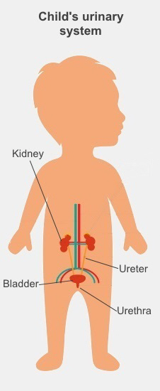
How Does The Urinary System Work?
3
What Is The Urinary System?
Kidneys – these two bean shaped organs work around the clock. They have various functions, including filtering waste products from the blood and producing urine (wee). They also balance a variety of electrolytes, as well as release hormones to control blood pressure and control red blood cell production. Furthermore, the kidneys help with bone health by controlling calcium.
Ureters – these are two thin tubes that take the urine (wee) from the kidneys to the bladder.
Bladder – this is the hollow, balloon-shaped organ that holds urine (wee) until it is time to go to the bathroom. This sac gets bigger as it fills with urine (wee).
Urethra – this is a tube that carries urine from the bladder out of the body when you wee.
Nerves in the bladder – the nerves warn a person when it is time to empty the bladder.
How Does The Urinary System Work?
The body extracts nutrients from your diet and coverts it into energy.
Waste products are then left behind in the bowel and blood.
The urinary system helps to remove urea from the body (liquid waste!). Urea is carried in the blood down into the kidneys where it is eliminated from the body with other waste products in the form of urine.
Developed by: Maria Langridge, Assistant Psychologist, Dr Lara Payne, Clinical Psychologist, and Dr Jenny Cropper, Clinical Psychologist.

Slide 4



Enuresis
4
What Is ‘Enuresis’?
The medical term for the inability to control urine in individuals who are already toilet trained. Such accidents commonly occur at night, when the individual is sleeping, but wetting can occur during the daytime as well. Daytime wetting occurs in roughly 3.5% of healthy children, with 67% of these children experiencing night time wetting.
Enuresis Signs/Symptoms Include…
Damp underwear, urine accidents during the day and irritation and/or redness around the genitals.
What Is ‘Nocturnal Enuresis’?
The medical term for the involuntary wetting during sleep. Bedwetting is considered as a medical difficulty when a child older than seven years of age has one or more episodes per month. Whilst the causes are not fully understood, help with this has a positive effect on the self-esteem of children and young people.
Nocturnal Enuresis Signs/Symptoms Include…
Many parents/carers observe wet bedding or nightclothes in children and young people with bedwetting.
If there is a urinary tract infection, then the child may experience painful/burning urination, increased frequency of urination, or a fever.
Developed by: Maria Langridge, Assistant Psychologist, Dr Lara Payne, Clinical Psychologist, and Dr Jenny Cropper, Clinical Psychologist.

Slide 5
Causes of Daytime Wetting
5
Dysfunctional Voiding
Many children who experience daytime wetting feel the urge to urinate at the last minute, and may ‘curtsey’ using their heel to stop the flow of urine. When the child/young person does go to the toilet, the outlet valve may not relax fully. This means that the bladder does not empty fully. This means that when the child returns back to what they were doing, the outlet valve will relax and urine leaks out. The child becomes at risk of urinary tract infections (UTI) when the bladder does not empty fully. UTI’s also increase the risk of bedwetting; indicators of UTIs include smelly and cloudy urine, pain or burning during urination, and stomach aches.
Weak Outlet Valve
The outlet valve opens and closes to control the flow of urine. A weak outlet valve may lead to a child/young person wetting themselves when they laugh, cough, or strain.
Structural Abnormalities
Structural abnormalities in the bladder or the kidney tubes can also cause daytime wetting. This can result in pain while weeing, a poor wee stream or continuous trickling wee.
Nerves
The brain and bladder are connected by nerves; messages are sent from the bladder to the brain via these nerves. Sometimes these messages get confused and the warning of urgency, sent from the bladder, is not received by the brain. The child then may not realise they need a wee.
Functional Causes
Enuresis can also be described as a functional disorder, meaning that it has a physical impact of the body without any apparent visible, organic, biological cause. Psychological factors contribute in the progress of functional disorders.
Constipation
A bowel that is full of stools presses against the bladder. The bladder then becomes squashed and struggles to expand to hold large amounts of urine. As a result, the child/young person feels the urge to urinate frequently, and has to do lots of little wees.
Developed by: Maria Langridge, Assistant Psychologist, Dr Lara Payne, Clinical Psychologist, and Dr Jenny Cropper, Clinical Psychologist.

Slide 6

Causes of Bedwetting
6
Bladder Size
Some bladders do not stretch enough to hold all of the urine made during the night.
Urine Production
Some people produce too much urine at night, the bladder cannot hold this extra urine.
Sleep
Some children/young people do not wake up when their bladder signals to their brain that it is full.
Constipation
A bowel that is full of stools presses against the bladder. The bladder then becomes squashed and struggles to expand to hold large amounts of urine. As a result, the child/young person feels the urge to urinate frequently, and has to do lots of little wees.
Type 1 Diabetes & Diabetes Insipidus
Symptoms of Type 1 Diabetes include more than typical urination, fatigue, weight loss, and thirst. People with Diabetes Insipidus experience excessive urination and increased thirst. If you are concerned you/your child may have diabetes please see your GP urgently.
Bedwetting is nobody’s fault, it does not happen because of laziness or bad behaviour. It is an accident! Children/young people should not be punished for accidents.
Developed by: Maria Langridge, Assistant Psychologist, Dr Lara Payne, Clinical Psychologist, and Dr Jenny Cropper, Clinical Psychologist.

Slide 7
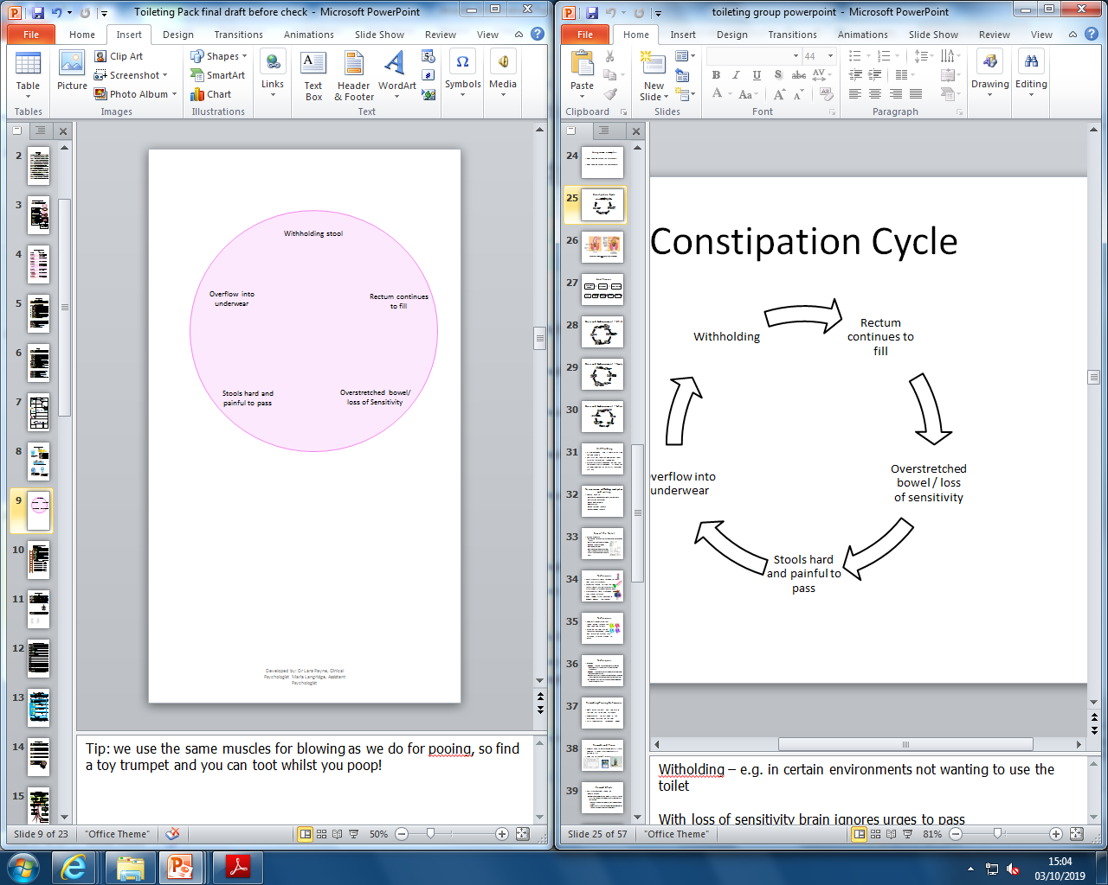
Modelling Enuresis and Nocturnal Enuresis
Nocturnal Enuresis
7
Under consumption of fluids during the day, over consumption of fluid in the evening.
Bedwetting
Insufficient production of the hormone involved in stopping urine production overnight.
Sleeping child does not feel the urge to urinate when they are sleeping (nocturnal enuresis).
Overstretched bladder/ loss of sensitivity
Sometimes a child may not drink enough during the day, and then drink more in the evening, filling the bladder before bed. The sleeping child may then not feel the urge to urinate resulting in bedwetting.
Some children do not produce enough of the hormone that stops urine production overnight, therefore too much urine is produced.
For other children the signals from the bladder to brain are not working as they should. This means the bladder overfills and stretches, and the signals between the brain and bladder become more confused. Finally, a child may withhold urination due to a fear of using the toilet, or because they do not like using the toilet in certain environments.
Developed by: Maria Langridge, Assistant Psychologist, Dr Lara Payne, Clinical Psychologist, and Dr Jenny Cropper, Clinical Psychologist.

Slide 8
Modelling Enuresis and Nocturnal Enuresis
Enuresis
8
Withholding urination
Overstretched bladder/loss of sensitivity confusing the signals between the brain and bladder
Daytime wetting
Possible development of UTIs.
Dysfunctional Voiding
A child who experiences daytime wetting may feel the urge to urinate at the last minute, and may ‘curtsey’ using their heel to stop the flow of urine. When the child/young person does go to the toilet, the outlet valve may not relax fully. This means that the bladder does not empty fully. When the child returns back to what they were doing, the outlet valve will relax and urine can leak out. The child becomes at risk of urinary tract infections (UTI) when the bladder does not empty fully. The bladder can continue to fill and become overstretched. This results in a loss of sensitivity and confusion of the signals between the brain and bladder.
Developed by: Maria Langridge, Assistant Psychologist, Dr Lara Payne, Clinical Psychologist, and Dr Jenny Cropper, Clinical Psychologist.

Slide 9


Physiological Support
9
Did you know?
You can see if you are drinking enough water based fluid by looking at the colour of your wee. Hydrated, healthy wee is a light yellow colour (almost like water). Dehydrated, unhealthy wee is a dark yellow colour, and means you need to drink more water!
Water
Drink the recommended amount of water (information provided in the table below) based fluid throughout the day to help your bladder fill and stretch. This helps the bladder to hold more urine and stay healthy. Drinking also helps to keep your bowels moving too! By drinking lots of water and keeping your bowels moving healthily, there is less pressure on the bladder, increasing its capacity. Drinking less fluid is more likely to result in constipation, worsening day and nighttime wetting.
Drinks with caffeine in them can make an overactive bladder misbehave. These drinks include some fizzy-pop, coffee, tea, and hot chocolate.
Try to do most of your drinking in the daytime and just drink a small cup of water an hour before bed, if you are thirsty.
Age (years) | Total drink intake per day
1-3 4–8 | 1 litre 1.2 litre
9–13 | 1.5 litre
14–16 | 2 litres
Diet
One of the causes of enuresis is constipation. It is important to eat a diet high in fibre, fruit, and vegetables (e.g. whole wheat products, peas, broccoli, carrots, sweetcorn and oranges, apples)
to enable healthy bowel movements. During episodes of constipation, the bowel presses against the bladder, limiting its capacity, meaning the child/young person urinates much more frequently. By having healthy bowel movements, the bladder has a larger capacity meaning urination will be less frequent.
Tip: Add more vegetables to soups and stews, have baked and boiled potatoes and keep the skins on, swap white bread for brown bread.
Developed by: Maria Langridge, Assistant Psychologist, Dr Lara Payne, Clinical Psychologist, and Dr Jenny Cropper, Clinical Psychologist.

Slide 10
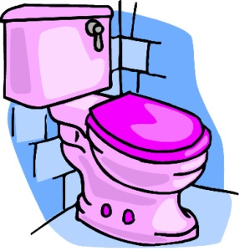
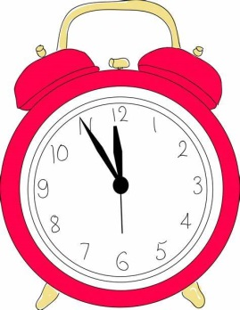

10
Toilet Routine
Try to have a regular toileting routine. Go to the toilet every 1.5 – 2 hours, even when you are busy doing something, it is important to listen to your bladder. Setting alarms might remind you to use the toilet. Try doing a wee before brushing your teeth and then another one just before you get into bed, so that your bladder is fully emptied before going to sleep.
When you do use the toilet, try to empty all of the wee out of your bladder. Sit down, relax, and take your time. Wee doesn’t need the same amount of force to push out like poo.
Bedwetting Alarms
Bedwetting alarms are attached to a sensor on the young person’s underpants, if the sensor gets wet the alarm goes off. This then wakes the young person up. Over time this should help the young person learn when they need to wee and wake up to go to the toilet.
A key element in the success of bedwetting alarms is the young person’s motivation and understanding that waking to the sound of the alarm is the treatment that will help to eliminate their night-time wetting. It is also important to start the treatment with realistic expectations. It can take an average of 2-3 months for a young person to be consistently dry at night, others can take longer. Furthermore, it is important that the child knows what to do when the alarm goes off (go to the bathroom, change their pjs, and strip the wet bedding).
More information about bedwetting alarms can be found at:
https://www.eric.org.uk/guide-to-bedwetting
Bladder Training
The aim of bladder training is to help your bladder get bigger and stronger. During this process you should drink a water-based drink every 1-2 hours, and try and wee 10 minutes after every drink. It will help if you are sitting on the toilet properly; girls should have their feet supported on a step, and boys might find it better to sit down to wee once or twice a day to help make sure the bladder is emptied properly. It is important to not rush when trying to wee, take time to empty your bladder completely. Try sitting on the toilet for 10-20 seconds when trying to wee; when finished, wait for 20-30 seconds and attempt to wee again to ensure the bladder is empty.
Developed by: Maria Langridge, Assistant Psychologist, Dr Lara Payne, Clinical Psychologist, and Dr Jenny Cropper, Clinical Psychologist.

Slide 11
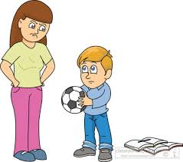
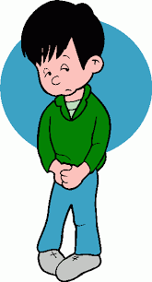
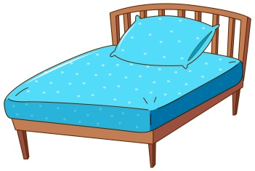


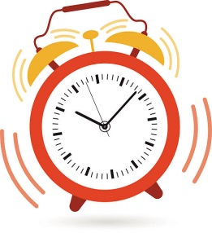
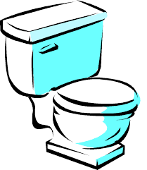
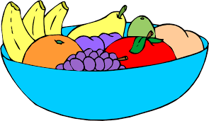



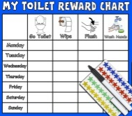


The Wendy Wee Comic: Beating Wendy Wee
11
Special acknowledgements to Michael White. Work adapted from ‘Beating Sneaky Poo’ leaflet published by Dulwich Centre Publications ©(available online)
Joe feels upset because people are blaming him.
Joe’s friends have been saying he smells, but Wendy is the smelly one! Joe’s parents get upset when Wendy makes a mess in Joe’s underwear and bedding. Everybody blames Joe, but Wendy never gets into trouble. Joe decides he wants to get back in charge of Wendy!
This is Joe. Joe is upset with Wendy for causing trouble, and for stopping him from doing things that he likes to do.
Wendy loves to play hiding games. Her favourite hiding places are in Joe’s tummy, under his bedsheets, and his underwear!
Joe knows that he will beat Wendy with lots of practice!
Joe starts eating a healthy diet high in fibre, with lots of fruit and vegetables. He also starts to drink a lot more water.
Joe is working on improving the signals from his bladder that tell him Wendy is about to arrive. He does this by setting regular alarms and sitting on the toilet every 1.5-2hrs. Joe knows it is important to practice everyday otherwise Wendy will keep playing hiding games in Joe’s tummy, pants and bed.
Joe wants some help getting back in charge of Wendy. He decides that Spiderman is going to help him. He puts a picture of Spiderman up in the toilet to remind him that Spiderman is supporting him to be in charge of Wendy. Who would help you to take control over Wendy? It could be a superhero, an animal, or anyone you would like! You can draw a picture of your supporter on the right, and write what they might say to you to help take charge.
Tip: You could time yourself to see how quickly you can go to the toilet and try to beat your time.
Joe plans his quickest routes to the toilet at home and school. He knows that Wendy can arrive quickly sometimes!
Joe sets up a chart, which he ticks each time he uses the toilet routine he planned, and also for every time he manages to keep Wendy from out of his pants and bed, and only in the toilet. Joe begins taking more control over Wendy.
Joe has a new friend – Wonderful Wendy! Unlike Wendy Wee, Wonderful Wendy tells Joe when it is time to go to the toilet, and helps Joe avoid anymore accidents.
Developed by: Maria Langridge, Assistant Psychologist, Dr Lara Payne, Clinical Psychologist, and Dr Jenny Cropper, Clinical Psychologist.

Slide 12
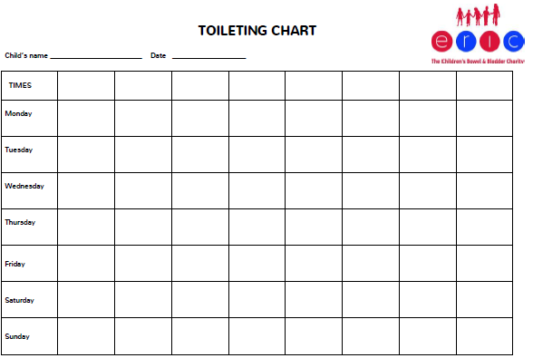
Toileting Reward Chart
12
An example of a toileting reward chart, from ERIC:
https://www.eric.org.uk/pdf-toileting-reward-chart
Advice for Parents and Children Using Toilet Charts…
Children and young people with bladder problems do not always know they need to go to the toilet. Effective toileting programmes can help to develop the child’s ability to urinate in the toilet.
Use the chart above to plan when the child should aim to sit on the toilet. Fill in the times that suit your child e.g. ‘waking up’, ‘after breakfast’ rather than having to go by hours on the clock. This will help them get in the habit of sitting on the toilet at regular points in the day. You may not need to use all of the time boxes provided.
It is important that children stick to their toilet routine whilst at school. Talk to their teachers to implement your toileting schedule whilst in school. You can provide schools with the following information: https://www.eric.org.uk/Pages/Category/help-at-school
When the child is sat on the toilet, they should be encouraged to sit for a few minutes at each specified time. Try using toys, games, or books to distract them. It will help if you can make it fun!
Increase goals gradually to help build stronger long term toileting habits. For example, agree with how many stickers the young person should aim for each week. Make it achievable. Gradually increase this over time.
Developed by: Maria Langridge, Assistant Psychologist, Dr Lara Payne, Clinical Psychologist, and Dr Jenny Cropper, Clinical Psychologist.

Slide 13
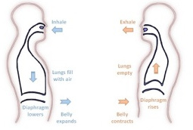


Contents: Guided Self Help Worksheets
13
Calming The Body - Feeling relaxed helps when trying to urinate.
Progressive Muscle Relaxation (PMR)………………………………………………………(See p.14)
Enuresis can cause a lot of emotional distress for children and young adults. Muscle tension is commonly associated with stress and anxiety, it is the bodies natural response to potentially dangerous situations. Even when there is no danger, our bodies can still respond in the same way. You may not always realise that your muscles are tense, it may be as subtle as your jaw clenching, or as obvious as your shoulders feeling really tight and hunched. PMR is a deep relaxation technique which is based upon the simple practice of tensing one muscle group at a time . This is followed by a relaxation phase with release of tension. This is very useful before bedtime.
Deep Breathing.……………………………………………………………………………….....….(See p.15)
During deep breathing your blood is oxygenated, triggering the release of endorphins, whilst also decreasing the release of stress hormones, and slowing down your heart rate.
Calming The Mind - Strategies for managing the anxiety
and stress that are often associated with nocturnal/enuresis.
Visualisation…………………………………………………………………………………...….…(see p.16)
Help yourself to feel more relaxed by thinking about things that make you feel calm and rested. For example, picturing your favourite place. This can be either independent, or you can take a guided visualisation approach. A guided visual imagery relaxation task has been provided in this pack.
Safe Place Visualisation……………………………………………………………………………(see p.17)
A powerful stress reduction and relaxation tool, that can be applied at any time, in any location.
The Ladder Hierarchy……………………………………………………………………………….(See p.18)
Help yourself to change how you cope with toileting difficulties, by gradually exposing yourself to different toileting scenarios over time.
Developing Coping-Self Talk…………………………………………..……………………....(see p.19)
These are phrases that you can say to yourself that are supportive. For example “Just because it has happened before it does not mean it will happen again”
Developed by: Maria Langridge, Assistant Psychologist, Dr Lara Payne, Clinical Psychologist, and Dr Jenny Cropper, Clinical Psychologist.

Slide 14















Progressive Muscle Relaxation
14
Get comfortable in a distraction free environment. You can either lay down or sit upright in a chair. Closing your eyes will help you focus on the different muscle groups, but you do not have to if you don’t want to! For all steps, hold the tense position for a couple of deep breaths, or however long is comfortable for you, then relax. Repeat each step three times.
Draw a deep breath in through your nose and feel your abdomen rise as you fill your body with air. Then slowly exhale from your mouth, pulling your belly-button towards your spine.
Start with your feet. Clench your toes with your heel pressing towards the ground. Squeeze tightly for a couple of breaths and then release. It may help to say ‘relax’ whilst you release the tension. Next, flex your feet with your toes pointing towards your head.
Next move to your legs. Stretch your leg out, with your toes pointing towards the sky, feel the back of your leg tightening. Hold this for a couple of deep breaths and then release. Then, point your toes down into the ground with your leg straight for a couple of deep breaths.
Now move onto your glutes. Squeeze your buttocks muscles for a couple of deep breaths. Remember, you should only feel tension and not pain.
To tense your stomach and chest, pull your belly button in towards your naval as tight as you can. Breath in deeply, filling up your chest and lungs with air.
Next, tense your shoulder blades and back. Push your shoulder blades backwards, as if you are trying to get them to touch. This will push your chest forwards.
Now tense the muscles in your shoulders as you bring your shoulders up towards your ears.
Be careful when tensing your neck muscles! Face forward, and SLOWLY pull your head back to look up at the ceiling.
Open your mouth as wide as you can, as if you are yawning, to tense your mouth and jaw.
To tense your eyes and cheeks, squeeze your eyes tight shut.
Raise your eyebrows as high as they will go, as if you were surprised, to tense your forehead.
To tense your upper arms, bring your forearms up to your shoulder to ‘make a muscle’.
Finally, to tense your hand and forearm, make fists with both of your hands.
Practice means progress. Only through practice can you become more aware of how your muscles respond to tensions and relaxation. Training your body to respond differently to stress is like any training – practice is the key!
Developed by: Maria Langridge, Assistant Psychologist, Dr Lara Payne, Clinical Psychologist, and Dr Jenny Cropper, Clinical Psychologist.

Slide 15

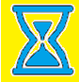
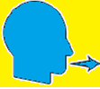
Calming The Body: Deep Breathing
15
During periods of anxiety, the body triggers the Fight or Flight Response. Breathing is shallow, uncontrolled, and muscles become tense. Deep breathing triggers the Relaxation Response, whereby breathing becomes deeper, controlled, slower, and the symptoms of anxiety reduce.
Sit or lie down comfortably. Close your eyes if it makes you feel more comfortable. Place your hand on your stomach, if you breath deeply enough, you should notice your hand rising and falling with each inhalation and exhalation. Imagine a balloon blowing up in your stomach as you breath in, and deflating as you breath out.
1. Inhale. Breath in slowly through your nose for 4-8 seconds.
2. Pause. Hold the air in your lungs for 4-8 seconds (however long is most comfortable for you).
3. Exhale. Breath out slowly through your mouth for 4-8 seconds.
Repeat. Practice for at least 2 minutes. As your technique improves, practice for 5-10 minutes.
Tips
Slow down. The most common mistake is breathing too quickly. Count each step slowly as you do so.
Counting your breaths takes your mind off of the source of anxiety. Counting acts as a distraction, whenever you catch your mind wandering, return to counting.
Developed by: Maria Langridge, Assistant Psychologist, Dr Lara Payne, Clinical Psychologist, and Dr Jenny Cropper, Clinical Psychologist.

Slide 16

Guided Visual Imagery Relaxation: The Beach
Lay down, or sit comfortably in a quiet room. Use the deep breathing techniques you learnt earlier in this pack, close your eyes and listen to somebody read you the following script. You can also read this script to yourself. You may find it more relaxing to play an audio track of crashing waves on the beach; this can be sourced on YouTube, Spotify, and most other online music platforms.
You’re walking down a long wooden stairway to a big, beautiful beach. It is very quiet and stretches off into the distance as far as you can see. As you look down you notice that the sunlight is reflecting off of the golden sand. You step into the sand, it feels warm so you wriggle your toes. You notice the warmth from the sand between your toes and around your feet. You notice the sounds of the waves crashing and chasing you up the shore, the water sparkles like a diamond as it retreats back. The roaring sound of the waves is so soothing that you can just let go of any worries.
The ocean is a beautiful light blue, with patches of darker sapphire in the deep. As you look at these deep blue areas you notice a small sailboat on the horizon. All of these sights help you to let go of any worries and relax even more.
As you continue walking along the beach, you become aware of the fresh salty sea air. You look up take a slow deep breath in, and breath out. This breath makes you feel refreshed and relaxed. As you look up you notice two seagulls, the wind gusts and they appear to dance in graceful circles above you. It makes you wonder how it would feel if you could fly under the warm sun.
You find yourself settling into a deep state of relaxation as you walk further down the beach. You feel the sun wrap its warm arms around you, the warmth relaxes all of your muscles. You notice a beach chair as you walk down the beach, once you reach it you take a seat. Laying back in this comfortable chair makes you reflect on everything you have felt, seen and thought at this beach. You drift into a deeper state of relaxation.
Now, feeling relaxed and at peace, you slowly rise from the beach chair and step into the warm sand to walk home. As you walk, you remember how relaxing this beach has been, and you know that you can come back to this place anytime you like. You start to climb the wooden stairs and gradually bring yourself back into the room. When you are ready, you can open your eyes.
16
Developed by: Maria Langridge, Assistant Psychologist, Dr Lara Payne, Clinical Psychologist, and Dr Jenny Cropper, Clinical Psychologist.

Slide 17
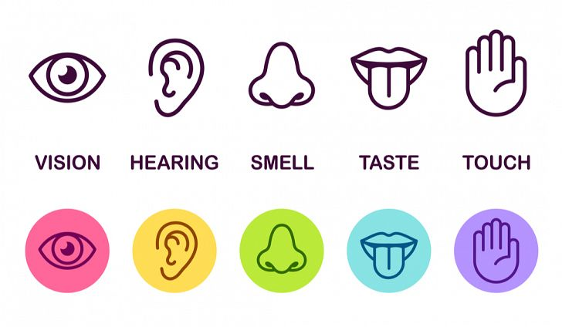
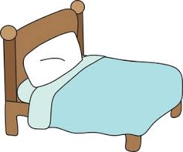
Relaxing Safe Place Imagery
17
All visualisations can be strengthened by engaging all of your senses in creating your ‘Safe Place’. If you any negative thoughts enter your positive imagery, discard that image and create another one.
Get comfortable in a quiet place where you won’t be disturbed. Sit, or lie, comfortably. Take a few minutes to practice some deep breathing, become aware of any tension in your body, and release it with each breath.
Imagine a place where you can feel safe and relaxed. Your safe place can be somewhere you have been on holiday, somewhere you have seen a picture of, or a completely new place you create. Avoid using your home as your safe place.
Look around your safe place, pay attention all the colours and shapes around you. Describe what you see aloud.
Now focus on what you can hear. Listen to the sounds far away from you, and those close to you. Perhaps you hear is silence. You may hear the sound of running water, or the crunch of leaves under your feet.
Now focus on any skin sensations. Notice the feel of the ground beneath your feet, or whatever is supporting you in this place. Pay attention to the temperature and direction of the wind, and anything else you can feel.
Take a deep breath in. Place your hand on your stomach, and imagine a balloon inflating in your stomach. Can you notice any smells there? Maybe you can taste the salty sea air as you inhale?
Pay attention to all of these sensations whilst you spend time relaxing in your safe place.
Whilst you’re in your safe place, give it a name that you can use to bring that image back at any time.
You can choose to stay for a while, enjoying the calmness and tranquillity. You can leave when you are ready by slowly opening your eyes and bringing yourself back to alertness in the present.
Developed by: Maria Langridge, Assistant Psychologist, Dr Lara Payne, Clinical Psychologist, and Dr Jenny Cropper, Clinical Psychologist.

Slide 18
Changing How I Cope With Toileting Difficulties:
The Ladder Hierarchy
18
Toileting difficulties can prevent us from doing things we like, such as going to the cinema, swimming, or spending time with friends. However, you cannot let these difficulties stop you! Ultimately, you need to face your fears if you want to overcome your anxiety around toileting. It may seem overwhelming in the beginning, however, it is much easier if you break the process down into smaller steps.
Construct a ladder of places or situations that you avoid because of anxiety around your toileting difficulties. At the top of the ladder, state the situation that you are most anxious about. At the bottom of the ladder, put places or situations you avoid , but don’t bother you as much. Give each item a rating of 0-10 according to how anxiety provoking the situation is.
Overcome the anxiety caused by your toileting problems by approaching these situations, starting from the bottom of the ladder. Make sure you write down what you think will happen, before approaching the task, and compare this with what actually happened.
Situation Anxiety (0-10)
Example: Going to a sleepover
10
Example: going to school
4
Developed by: Maria Langridge, Assistant Psychologist, Dr Lara Payne, Clinical Psychologist, and Dr Jenny Cropper, Clinical Psychologist.

Slide 19

Develop Coping Thoughts/Positive Self-Talk
Positive statement encourage us and help us cope through distressing times. We can use these statements to replace the negative thoughts we experience during these distressing times. We can act as our own coach by saying these encouraging thigs to ourselves. Some examples include:
19
“I can do this.”
“I can cope.”
“Keep calm and carry on.”
“Thoughts are just thoughts – they are not necessarily fact.”
“It is okay to feel this way, it is a normal reaction.”
“This is difficult, but it is only temporary.”
“This wont last forever.”
Activity:
Situation | Coping Thought/Positive Statement
Example: I have started in a new school. I do not know anybody here yet. I am worried about wetting myself around them. | It is okay, I have spare clothes and wet-wipes so I can clean myself up. It is normal to worry about this situation, but I know I can clean up quickly and quietly.
I have exams in the next couple of weeks, they are really important. I am worried I will have an accident during the exam.
My friend has invited people over to her house for a sleep over. I am scared I will have an accident.
I am starting a new school. I do not know where the toilets are, and I am worried I will not find them when I need them.
Developed by: Maria Langridge, Assistant Psychologist, Dr Lara Payne, Clinical Psychologist, and Dr Jenny Cropper, Clinical Psychologist.

Slide 20


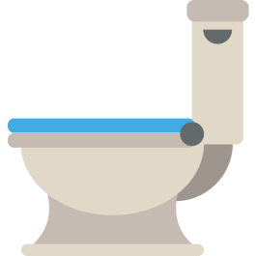
Information for Parents/Carers and Teachers
20
Understand What Enuresis Is
To understand the young person, you must first need to know what enuresis is, and what causes it. There are many potential causes of enuresis and nocturnal enuresis as described on pages 5 and 6 in this pack.
Normalise The Toilet
It is important to talk openly and honestly about going to the toilet.
This allows those close to the child to intervene at an early stage with simple measures to help them use the toilet.
Allowing your child to observe normal toileting behaviour, such as seeing parents use the toilet frequently, shows the child that the toilet does not need to be feared.
‘Toilet Area’
Sometimes it is necessary to build up confidence to sit on the toilet and relax before the child can comfortably pass urine on the toilet. Suggest that children who insist on using a nappy to urinate do so in the toilet area. Adopt a gradual exposure approach; encourage the child to sit on the toilet with the nappy on, and over time gradually remove it. It is important to create an environment without anxiety and pressure.
Developed by: Maria Langridge, Assistant Psychologist, Dr Lara Payne, Clinical Psychologist, and Dr Jenny Cropper, Clinical Psychologist.

Slide 21


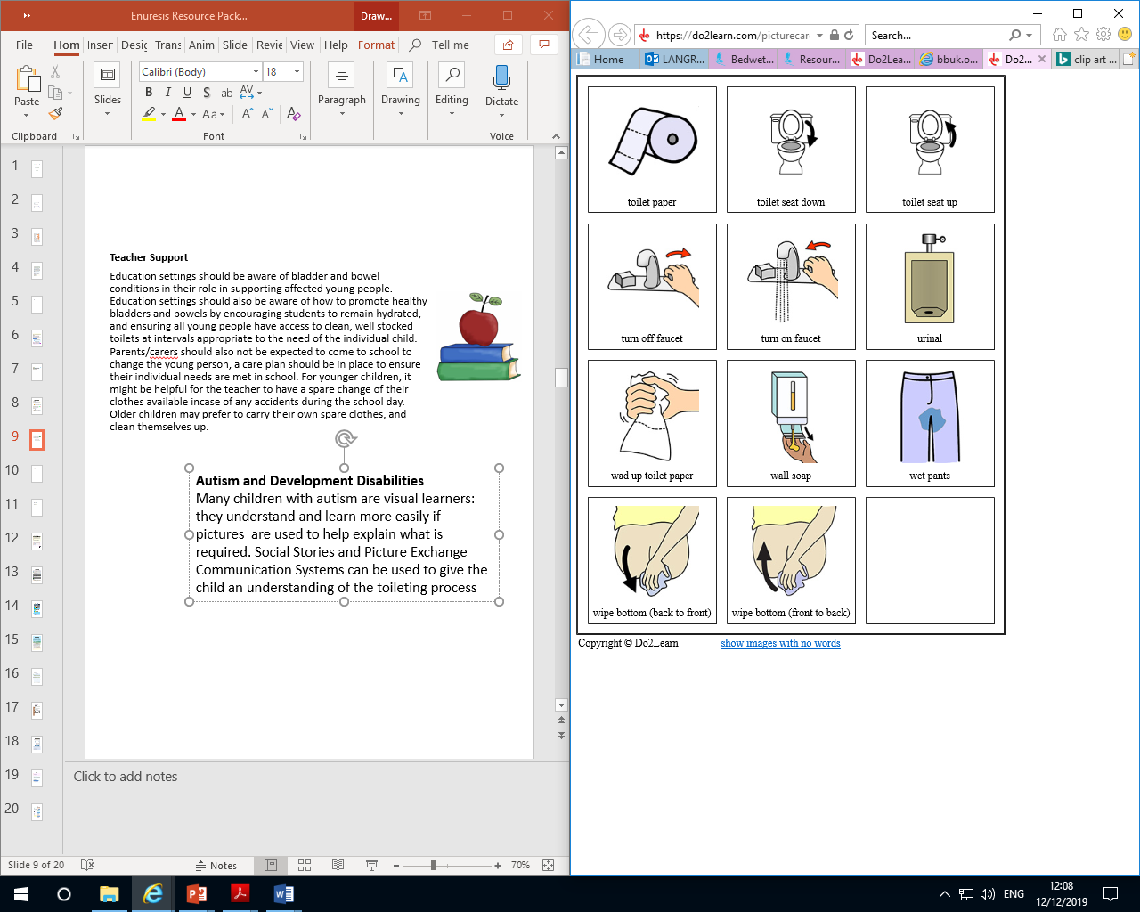
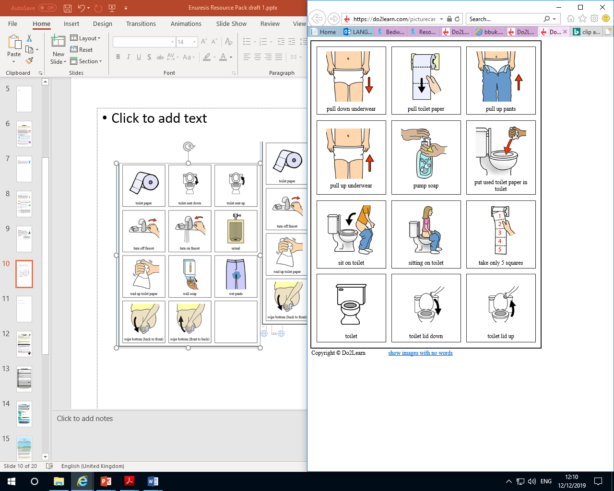
21
Teacher Support
Education settings should be aware of bladder and bowel conditions in their role in supporting affected young people. Education settings should also be aware of how to promote healthy bladders and bowels by encouraging students to remain hydrated, and ensuring all young people have access to clean, well stocked toilets at intervals appropriate to the need of the individual child. Parents/carers should also not be expected to come to school to change the young person, a care plan should be in place to ensure their individual needs are met in school. For younger children, it might be helpful for the teacher to have a spare change of their clothes available incase of any accidents during the school day. Older children may prefer to carry their own spare clothes, and clean themselves up.
Be Positive, Encouraging, Patient, and Understanding.
Evidence of your support, encouragement, and understanding will help your child to relax and eventually move forward in their journey to overcoming enuresis. Your support and understanding is VITAL – they can do it if you think they can. It is important to understand bedwetting is a medical condition, and is not the young persons fault.
Supporting Those With Autism and Development Disabilities
Many children with autism are visual learners: they understand and learn more easily if pictures are used to help explain what is required. Social Stories and Picture Exchange Communication Systems can be used to give the child an understanding of the toileting process.
It is important that you make it clear you are not annoyed or cross with the young person, you are just trying to help.
Developed by: Maria Langridge, Assistant Psychologist, Dr Lara Payne, Clinical Psychologist, and Dr Jenny Cropper, Clinical Psychologist.

Slide 22
Online Support
22
Apps:
Mindfulness and Sleep:https://www.smilingmind.com.au/
Meditation and Sleep:https://www.calm.com/
Meditation: https://www.headspace.com/kids
Progressive Muscle Relaxation: https://www.thinkpacifica.com/
Websites:
ERIC, the Bladder and Bowel Charity website:
https://www.eric.org.uk/
There is a free downloadable Guide to Children’s Toileting Problems. ERIC have also created Poo and Wee characters and a range of videos for children and parents.
Bladder and Bowel UK website : https://www.bbuk.org.uk/children-young-people/
National Institute for Health and Care Excellence (NICE) Guidelines: www.nice.org.uk/guidance/CG111
Books:
Bedwetting In Children and Young People: A Simple Guide For Parents – Dr C Yemula
General resources:
Free Online Counselling for Young People: https://www.kooth.com/
Stress and Anxiety: https://www.moodcafe.co.uk/for-children-and-young-people/feeling-worried,-frightened,-stressed-or-anxious.aspx
Relaxation Techniques: www.getselfhelp.co.uk/relax.htm
Relaxing Imagery: www.getselfhelp.co.uk/imagery.htm
Thought Distancing: www.getselfhelp.co.uk/cbtsetp6.htm
When accessing online resources and communities, it is important that children and young adults are supervised, and are aware of online safety.
Developed by: Maria Langridge, Assistant Psychologist, Dr Lara Payne, Clinical Psychologist, and Dr Jenny Cropper, Clinical Psychologist.
Notes:
More resources specifically for wetting.

Slide 23
Local Support
23
No5
101 Oxford Road,
Reading, Berkshire,
RG1 7UD
Counselling phone: 0118 901 5668
Admin phone: 0118 901 5649
Email: info@no5.org.uk
Free, confidential counselling to support children and young people aged 10-25, living in the vicinity.
https://no5.org.uk/
Youth Enquiry Service (YES)
52 Frogmoor, High Wycombe, HP13 5DG
Contact number: 01494 437373
Email: info@yeswycombe.org
Free confidential counselling for young adults aged 13-25, living in the vicinity.
https://www.yeswycombe.org/
ARC Youth Counselling
35 Reading Road, Wokingham, Berkshire, RG41 1EG.
Contact number: 0118 977 6710
Email: coordinator@arcweb.org.uk
counsellor@arcweb.org.uk
Free and confidential counselling for those up to the age of 18, living in Wokingham .
https://arcweb.org.uk/
Number 22
Where to go:
27 Church St.
Slough, Berkshire
SL1 1PL
Who to contact:
Telephone (Youth Talk, Windsor): 01753 842444
Telephone (Number 22, Maidenhead): 01628 636661
Free and confidential counselling for 12-25 year olds, living in the vicinity.
https://number22.org/
Youth Concern
The Uptown Coffee Bar, Whitehill Lane, Aylesbury, Buckinghamshire, HP19 8FL.
Contact number: 01296 431183
Email: http://youthconcern.org.uk/
Free and confidential counselling for young people aged 13-25 living in Aylesbury Vale, Buckinghamshire.
http://www.youthconcern.org.uk.fluent5.sites.fluent.ltd.uk/
Your GP is available to talk to you about any mental health worries, or concerns about toileting.
Developed by: Maria Langridge, Assistant Psychologist, Dr Lara Payne, Clinical Psychologist, and Dr Jenny Cropper, Clinical Psychologist.

